Slide 1
My practice in Portugal
Ewelina Zajko

Slide 2
Flag
The Red color symbolises blood and the fight.
When it comes to Green, we don’t exactly know its significance but it’s assumed that it may stand for Portuguese’s beautiful green areas as well as everlasting spring.
The White color stands for peace and harmony.
Coat of arms:
Armillary sphere represents geographical discoveries and marine conquests.

Slide 3
Location
Portugal, officially called Republica Portuguesa, is located in the south-western part of Europe and it is the westernmost country which borders with Spain from the East and is surrounded by the Atlantic Ocean from the West. It also owns two islands lying in the Atlantic Ocean called Madera and Azores. It is the member of EU and NATO organiazation too.
Braga

Slide 4
The biggest cities are:
„In Braga people pray, in Porto they work, in Coimbra they study and in Lisbon they live their lives”.
Lisbona – 770 000 residents
Porto - 307 000 residents
Amadora - 181 000 residents
Setúbal - 103 000 residents
Funchal - 115 400 residents
Braga - 63 000 residents
Coimbra – 60 000 residents

Slide 5
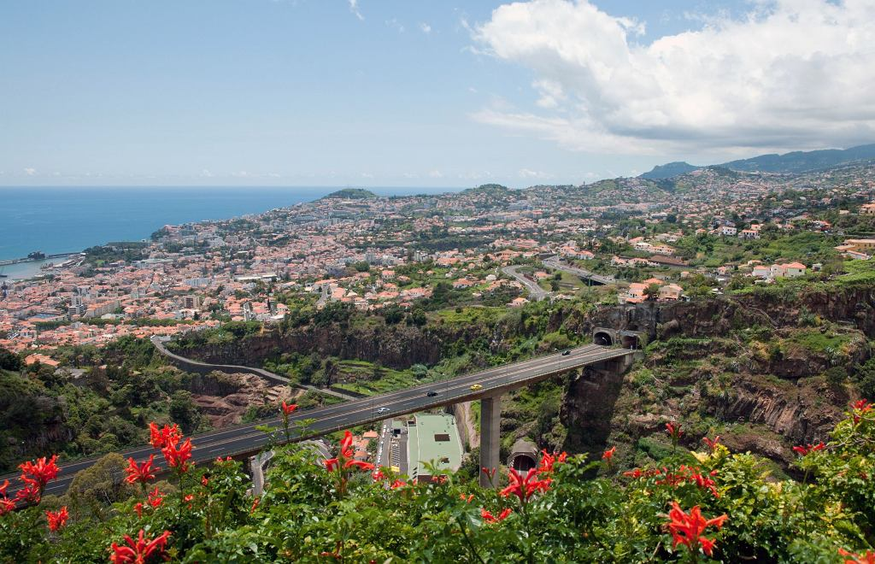
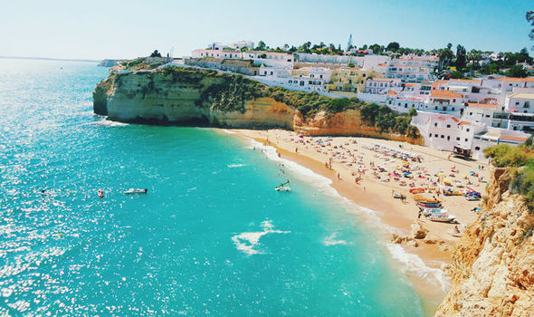
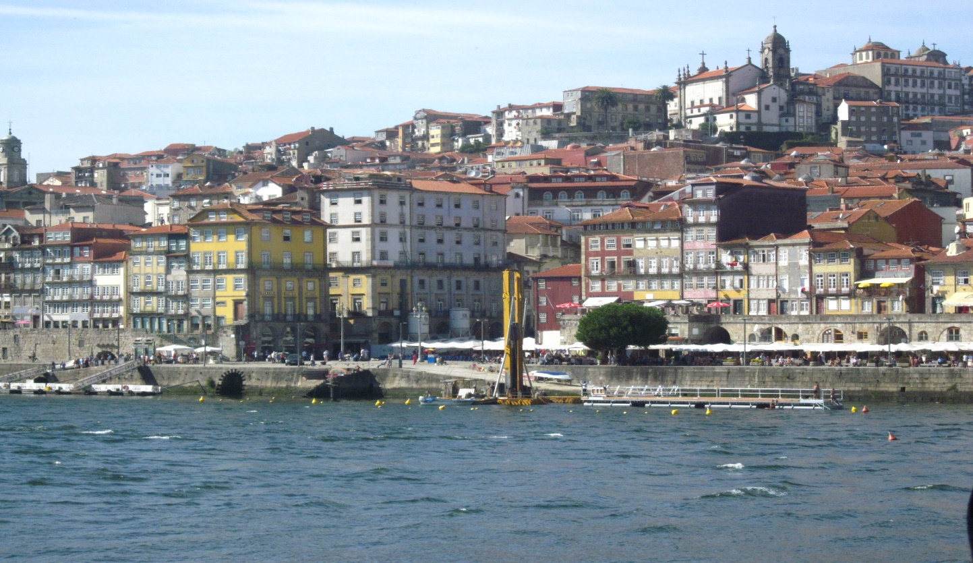
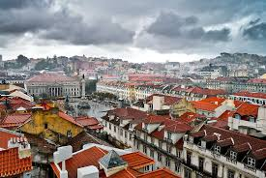
WEATHER
The Mediterranean climate which is characteristic for Portugal means that in the winter the temperatures are clearly diffrent in the south and in the north part of the country. As a result, the region Algarve is warm and sunny with the possibility of sunbathing through the whole year, whereas in Lisbon the days are sunny and rainy in turn. Summers are mainly really hot.

Slide 6
Culture:
Portuguese men greet women with a great respect. People living there take their time and do not rush whatsoever. Instead, they really enjoy their lives and even dinner time is mostly treated as a social meeting than just having a normal meal and it lasts more than 2 hours.

Slide 7
Tourism
Portual is famous for its many touristic attractions.
In Lisbon you can see the oldest yellow tram no 28, which you can take to travel among narrow streets of the city.
In Tomar you explore a mighty castle, founded in 1166 as the headguarters of the Order of the Knights Templar.
In Braga, which is one of the most important pilgimage sites in the country, there is the Portugal’s grandest religious sanctuary called Bom Jesus do Monte.

Slide 8
Well-known festivals
30.07-13.08- Ocean festival
03-07.08-the largest music festival
26.08-02.09-wine festival
05-15.08-festival of the Medieval Times
22-28.08- competition of bodyboarding

Slide 9
Why do I want to visit Portugal?
to develop as well as practise my English skills
to experience my first plane journey
to get to know a new culture
to savour the new dishes of Portguese cuisine
to improve my practical skills
to acquaint with new interesting people
to promote the Polish culture among Portuguese people

Slide 10
Tourada- ‘bullfight’
The aim of the fight is to provide the spectators with the incredible spectacle and harness the animal. Though the animal rights activists are against such an event, the government do not want to resign from that sport. Unlike the Corrida, bulls mustn’t be killed, however people get hurt quite frequently.

Slide 11
My interest in Portugal
My dream is to see the lusitano horse breed raised in that area, not the one that is met here, in Poland. I would also like to practise riding a horse in a Spanish style in Quintana Gontem near Lisbon, which is different from the classical English style that I ride everyday.
Not only were these horses created to take part in horse contests but also to herd the cattle.

Slide 12
What else would I like to try?
Portugal is also renowned for surfing due to the biggest waves, reaching even 2 metres. That’s why summer is usually the best option for beginning surfers whilst the fall for ones with high and intermmediate level skills.
I’ve always wanted to try such extreme sports and I believe it to be the greatest adventure ever.

Slide 13
Portugal, CU!

