Slide 1
My placement in Italy

Slide 2
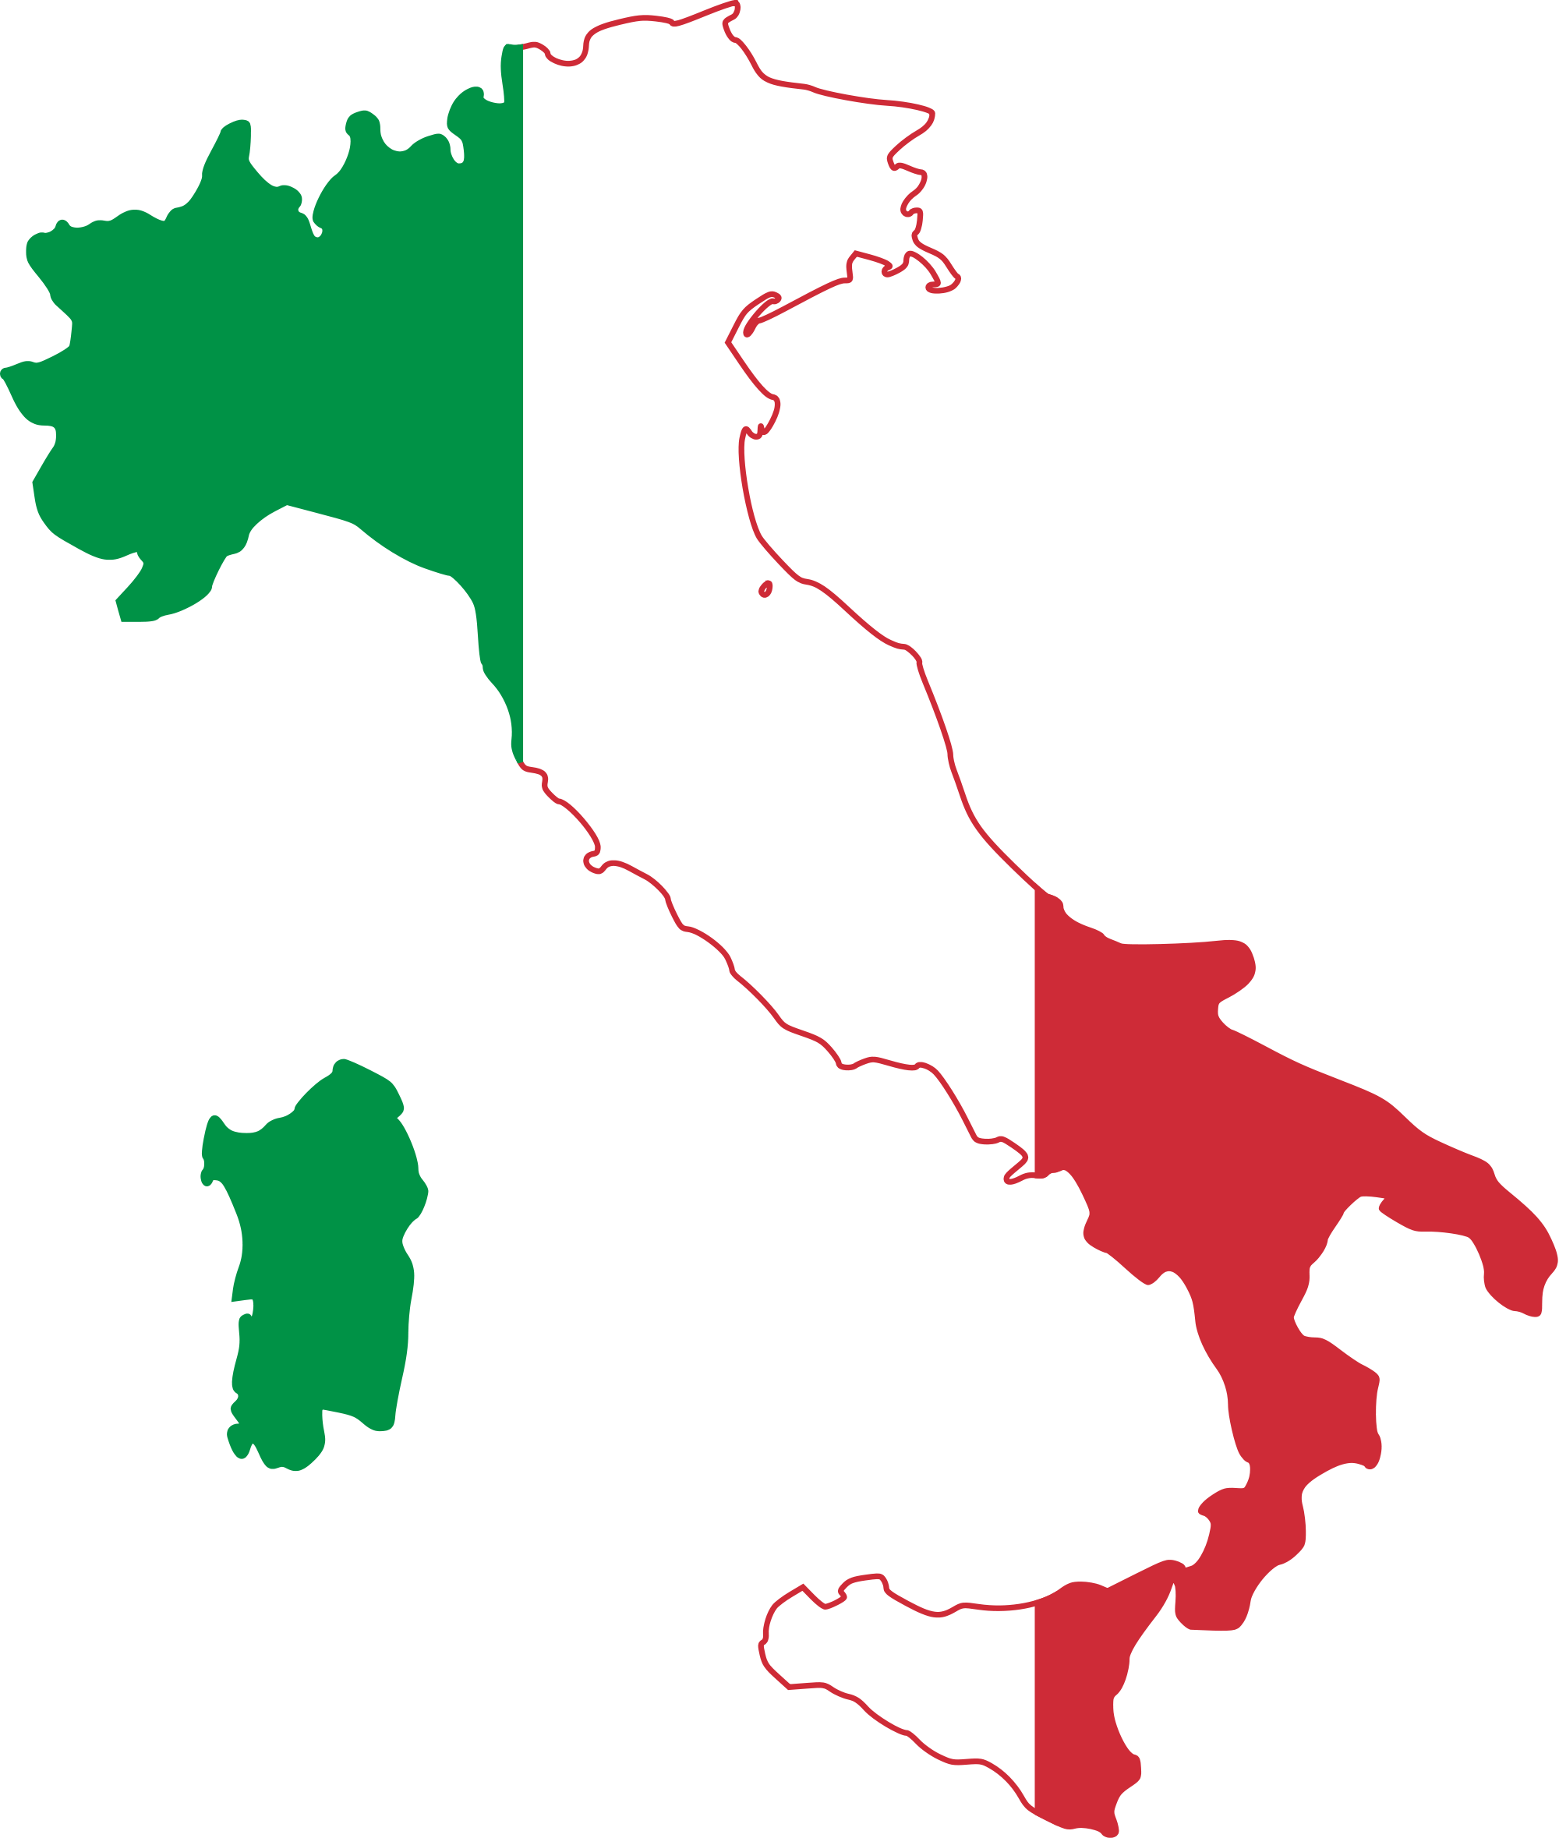
Map, emblem and flag

Slide 3
Basic information about Italy
It is a country located in south Europe, on Apennine Peninsula, which is a member of the European Union.
Capitalcity: Rome
Offical language: Italian
Population: 60,7 mln
Surface: 301.340 km²
Currency: Euro €
Faith: Catholicism (83.2%)

Slide 4
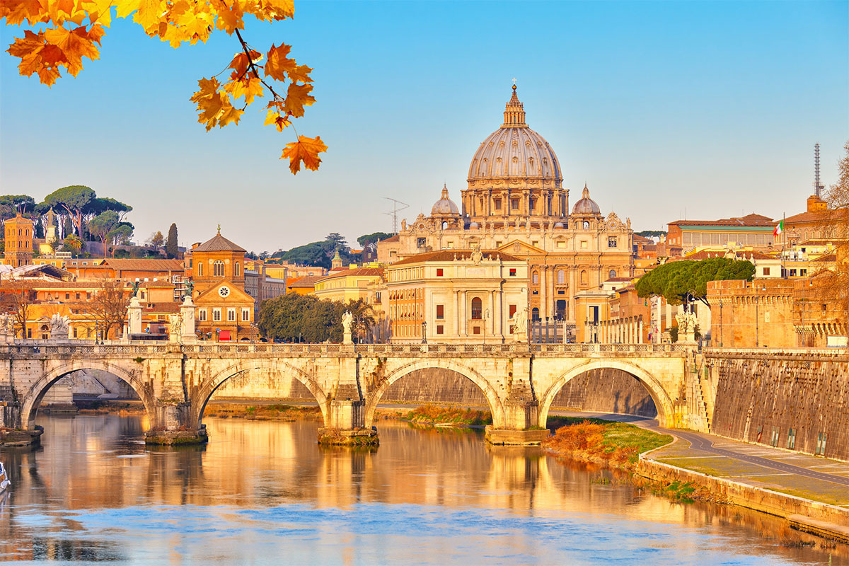
The biggest cities in Italy:
Rome

Slide 5
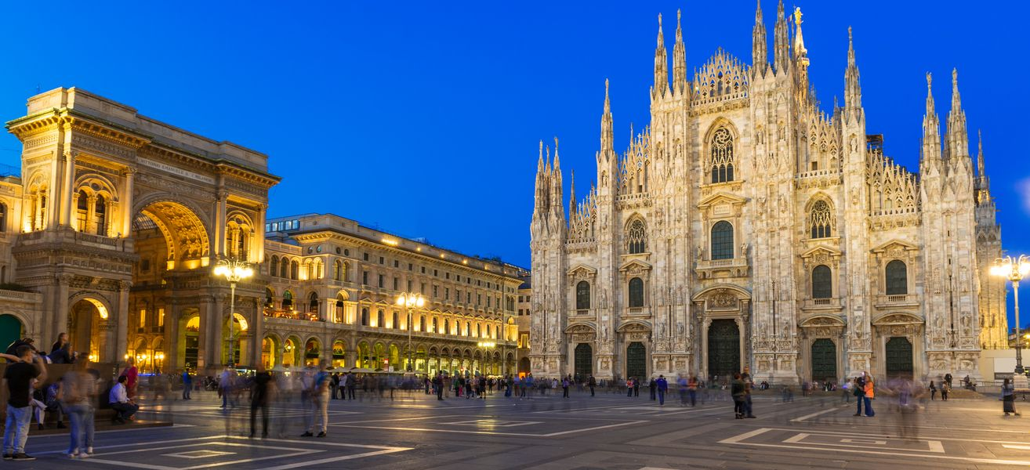
The biggest cities in Italy:
Milan

Slide 6
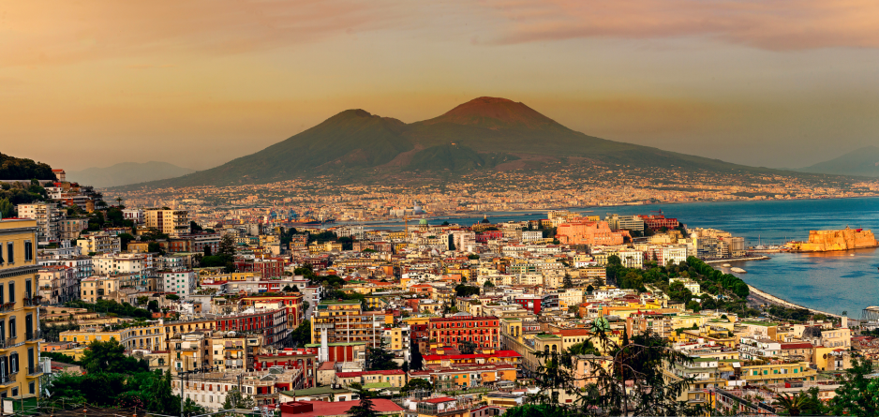
The biggest cities in Italy:
Naples

Slide 7
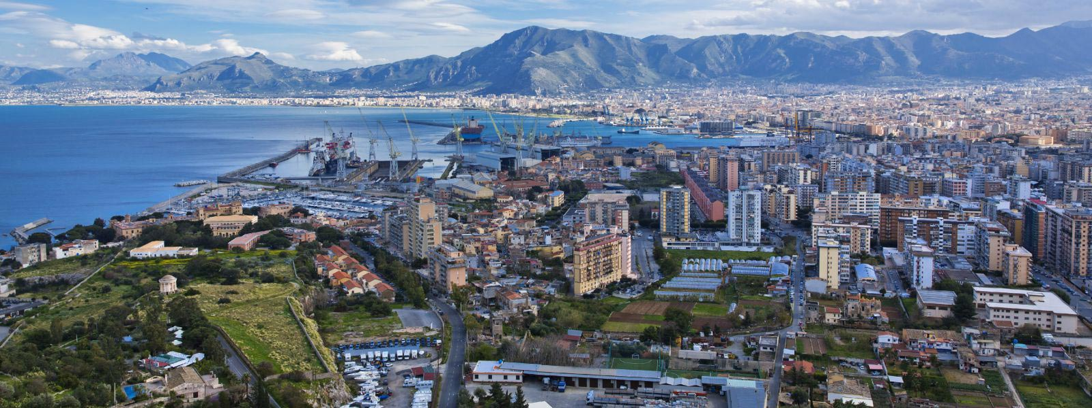
The biggest cities in Italy:
Palermo

Slide 8
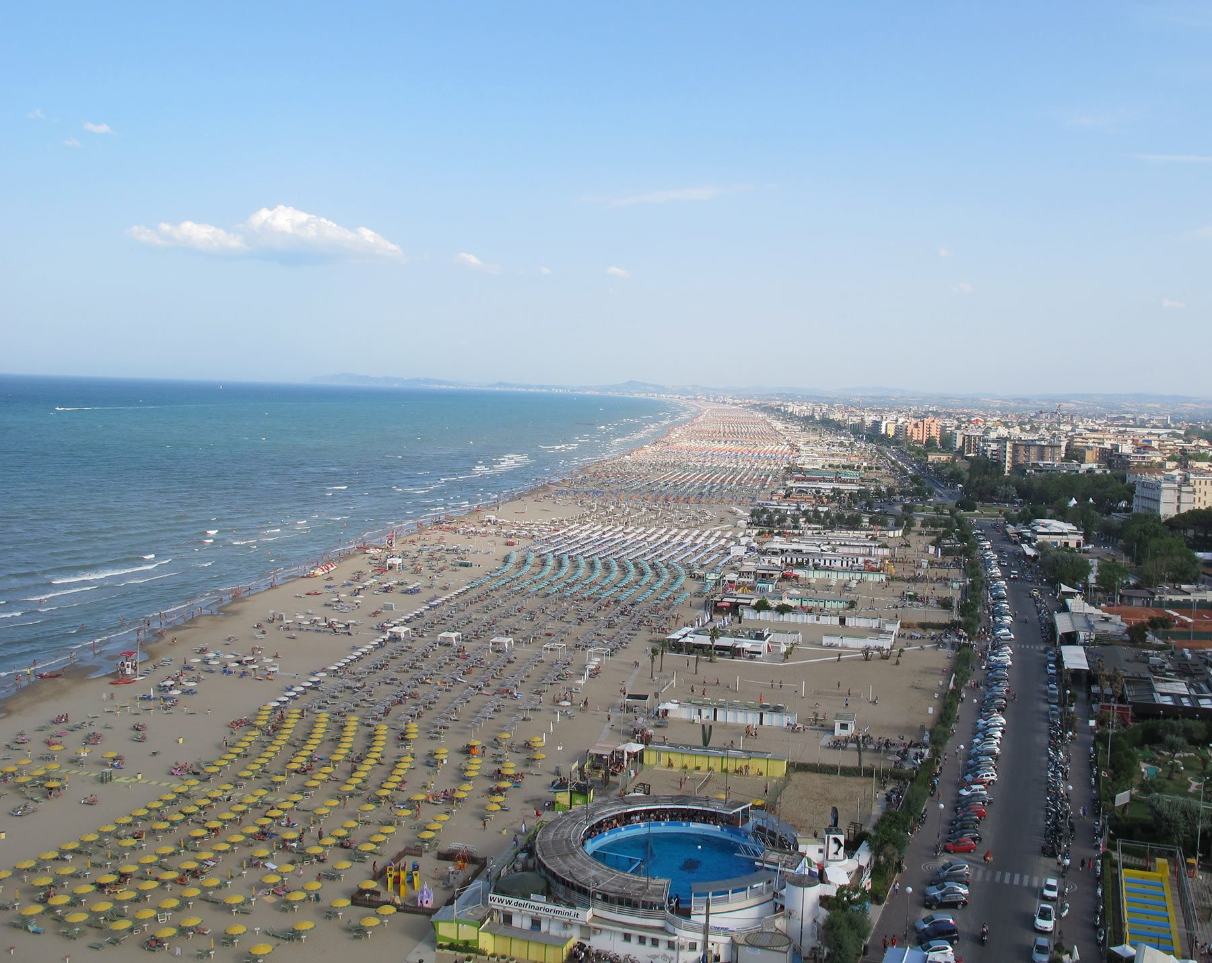
Rimini
The place, where is going to take place our placement is Rimini. It’s located on the Adriatic Sea, on the coast between the rivers Marecchia and Ausa. It is one of the most visited by tourists city in Italy. City, which is placed near to Rimini is well-known San Marino

Slide 9
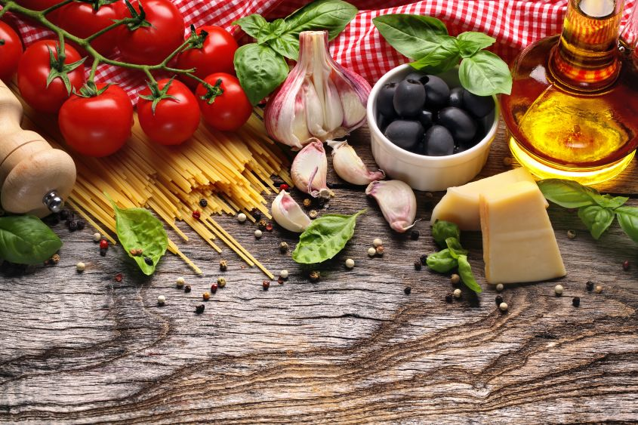
Italian cuisine
Italian cuisine is quite known in my family. Person who ”meet” me with Italian cuisine was my aunt, who lives in Italy. It’s mainly based on wide range of vegetables (basis are tomatoes) and spicies and also herbs, like: basil, oregano, rosemary, thyme and coriander, garlic, etc. The most popular ingredient is homemade olive oil.

Slide 10
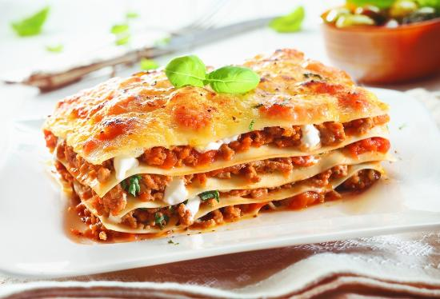
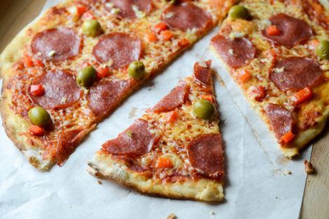
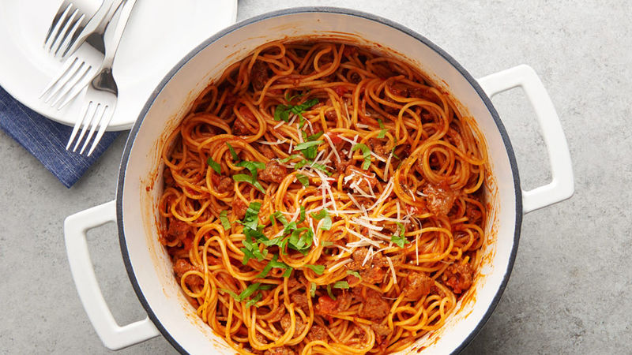
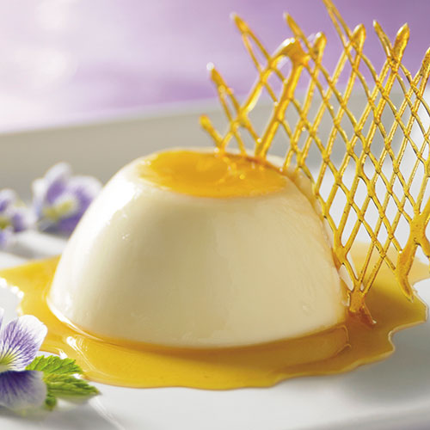
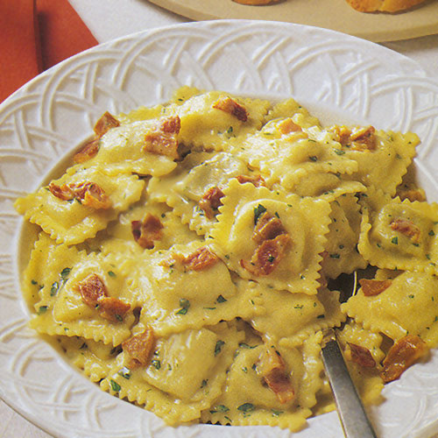
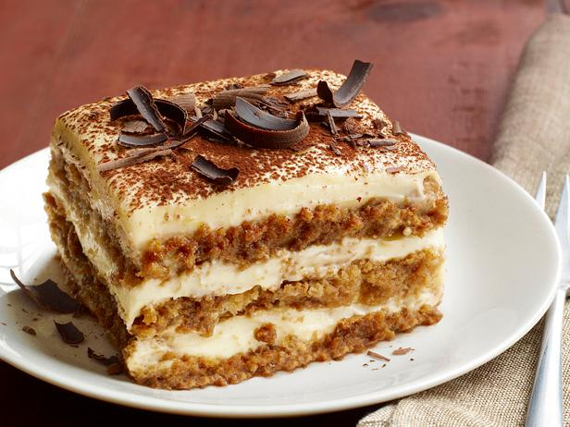
THE MOST POPULAR COURSES and desserts IN ITALY:
Pizza
Lassagne
Ravioli
Spaghetti
Panna Cotta
Tiramisu

Slide 11
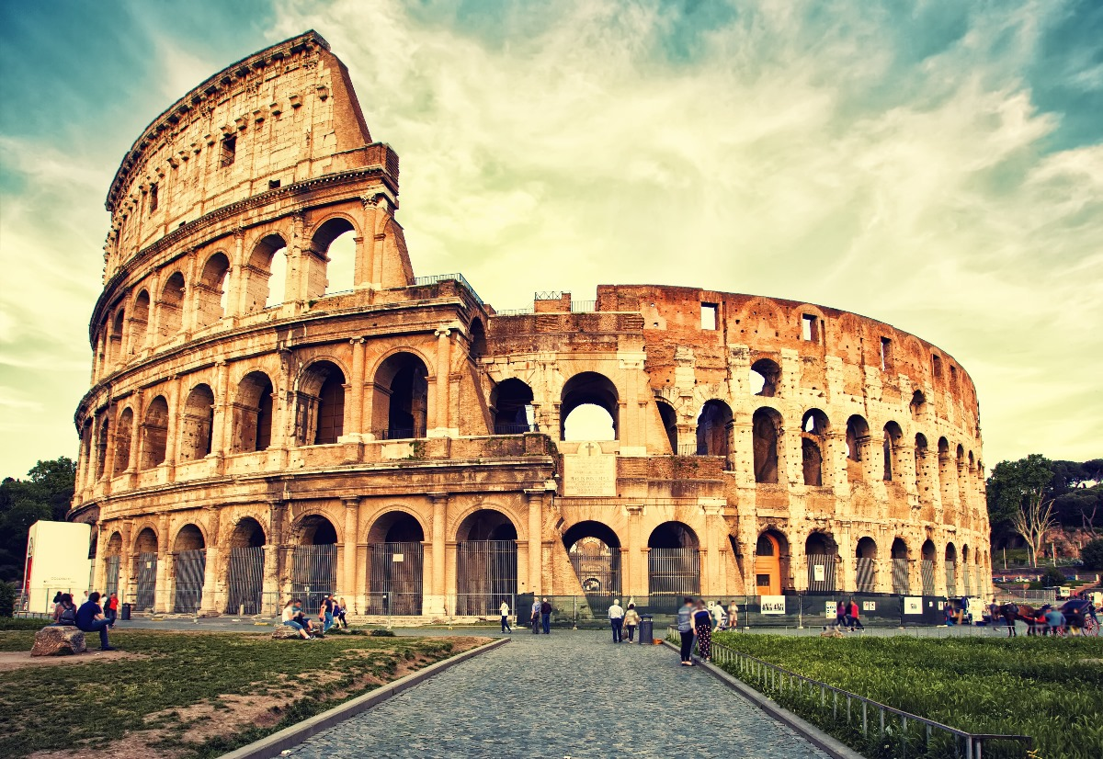
The most famous monuments:
Colosseum

Slide 12
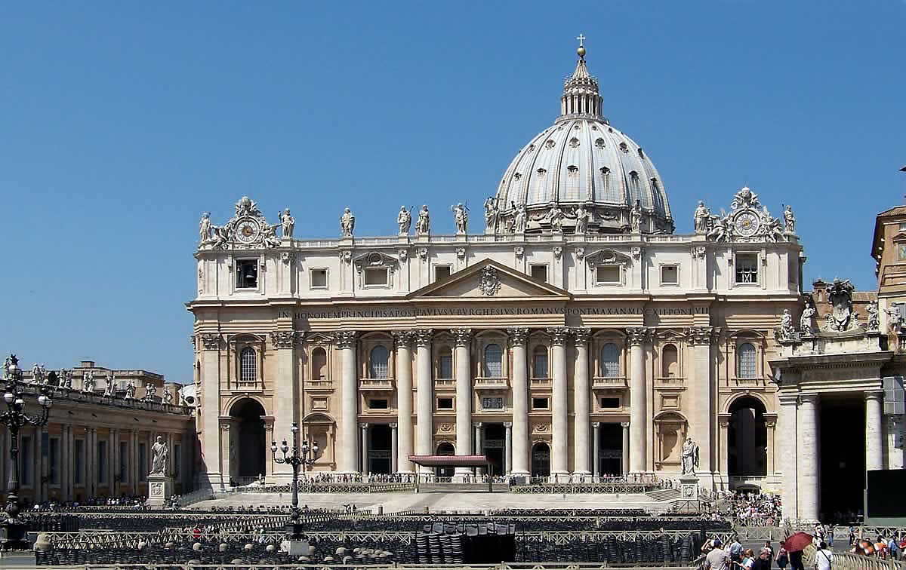
The most famous monuments:
Saint Peter's Basilica

Slide 13
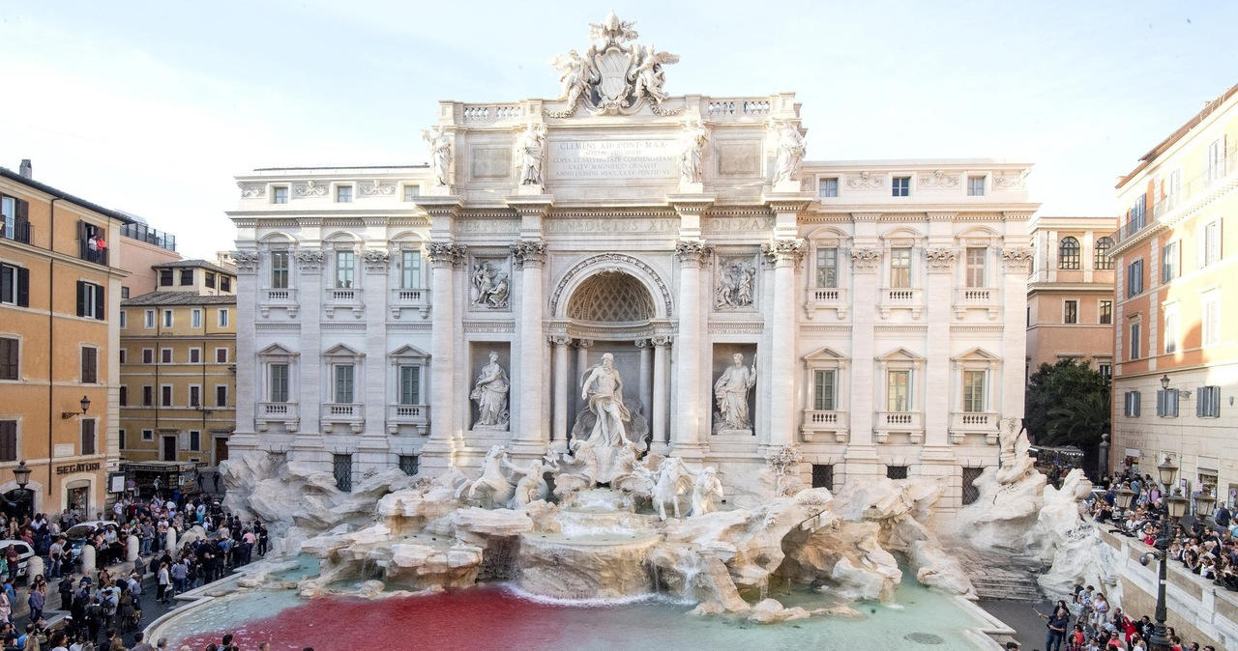
The most famous monuments:
Trevi Fountain

Slide 14
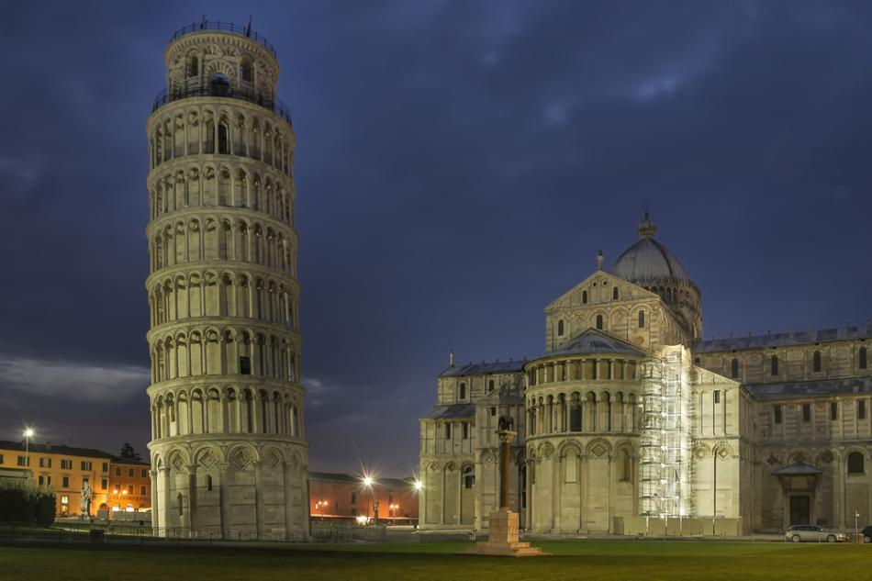
The most famous monuments:
Leaning Tower of Pisa

Slide 15
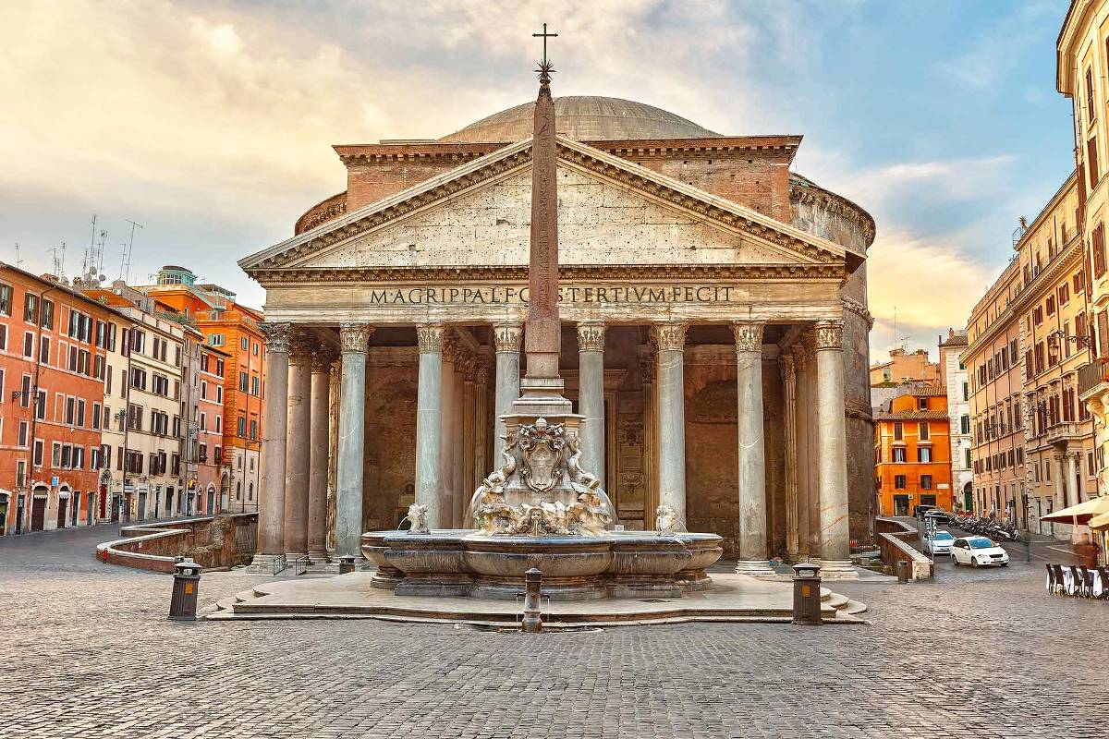
The most famous monuments:
Pantheon

Slide 16
People in Italy
From my aunt’s story, i can tell, that people in Italy are very sympathetic and helpful. Sometimes it seems like they are screaming each other during conversation, but they just talk so loudly. Italians like children, hence they let them just for everything. People there are really chaotic and they express their feelings.

Slide 17
Basic phrases in Italian:
*Yes-SI *No-NO *Please-PREGO *Thank you-GRAZIE *Sorry-SCUSI *Hi-CIAO *Good morning/afternoon/evening- BUONGIORNO *Good Bye-ARRIVEDERCI *How are you?-COME VA? Something for boys, Hai un Beli Occhi- You’ve got beautifull eyes

Slide 18
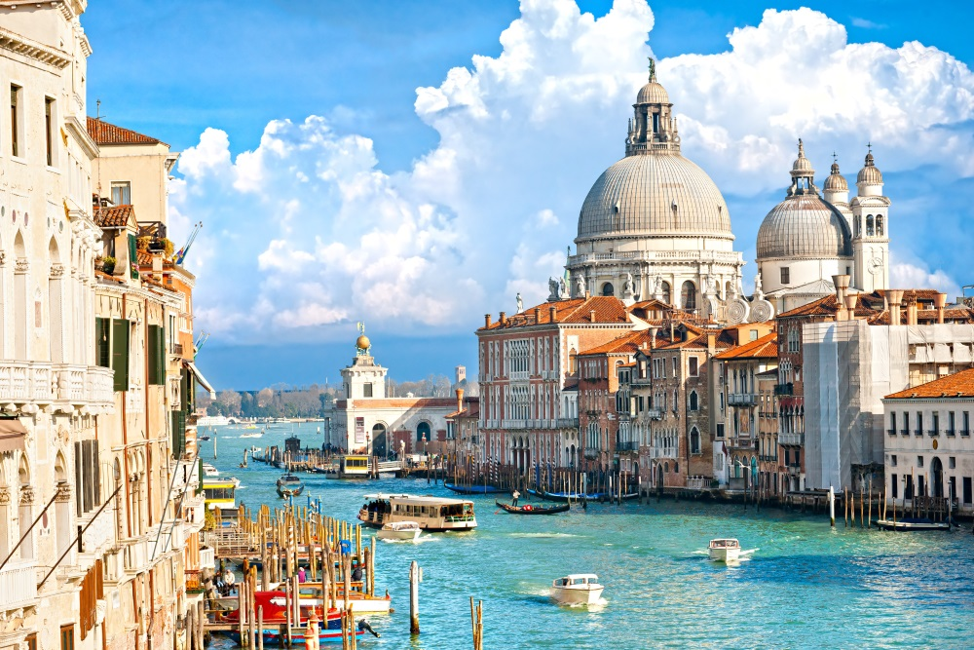
Places, which i would like to visit:
Venice

Slide 19
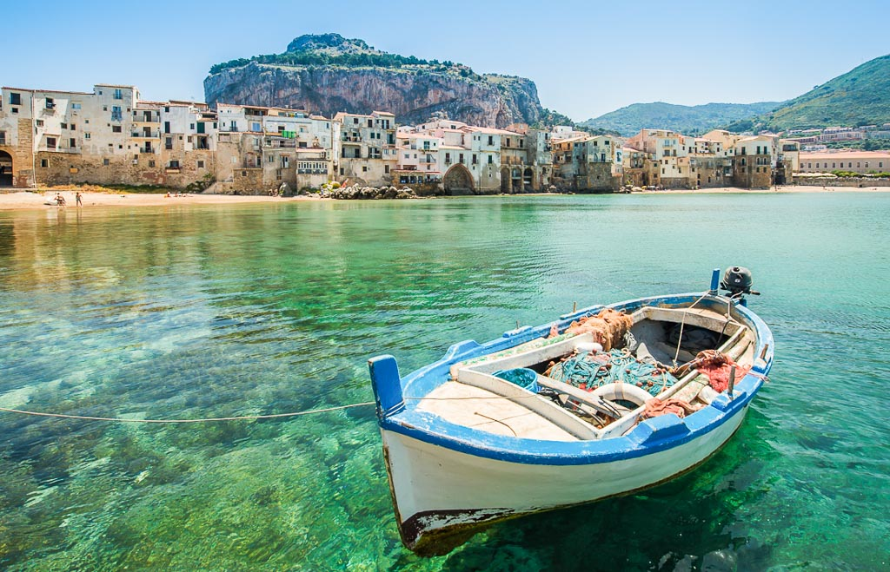
Places, which i would like to visit:
Sicilia

Slide 20
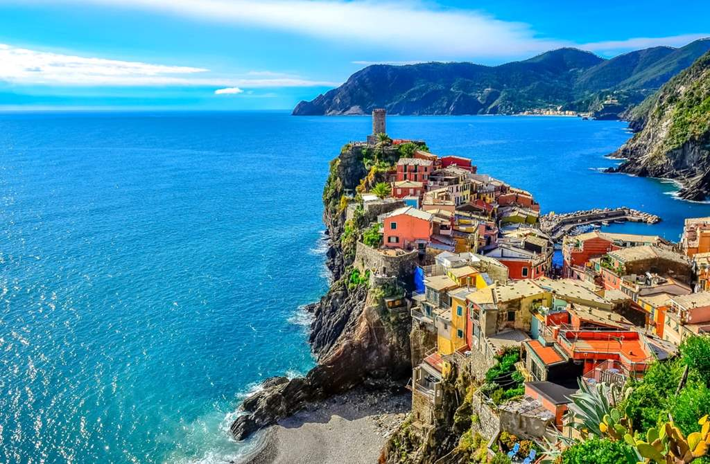
Places, which i would like to visit:
Cinque Terre

Slide 21
Thank you for your attention!
Made by: Kinga Tworek kl II TWŻ

