Slide 1
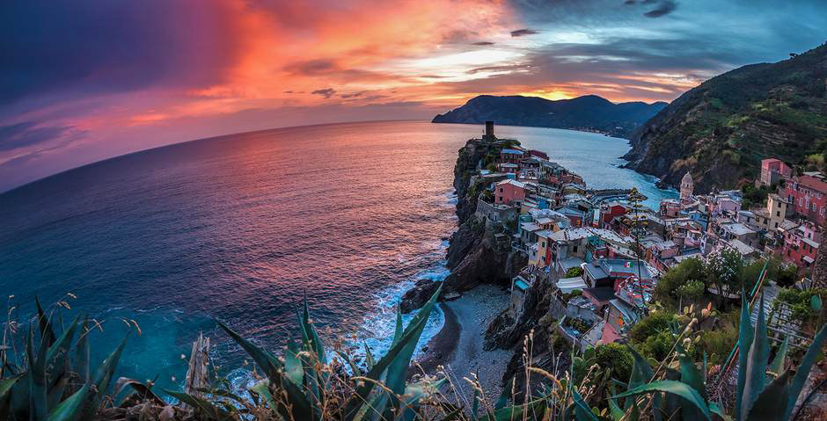
My internship in Italy
Szarek Wiktoria
Klasa II – technik usług fryzjerskich

Slide 2
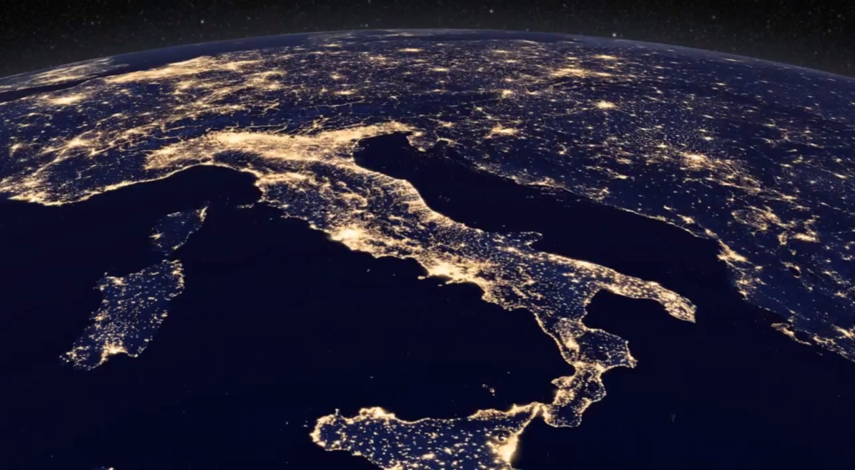
Italy
The Italian Republic is a state in the southern part of Europe, located on the Apennine peninsula , surrounded by the waters of the Mediterranean ,Adriatic Sea, Ionian, Tyrrhenian and Ligurian Seas. Italy borders on Austria, Slovenia, Switzerland and France.
Area 301,230 km² Population 60 million
Currency Euro Capital Rome Religion catholic Official language Italian
Phone code +39

Slide 3
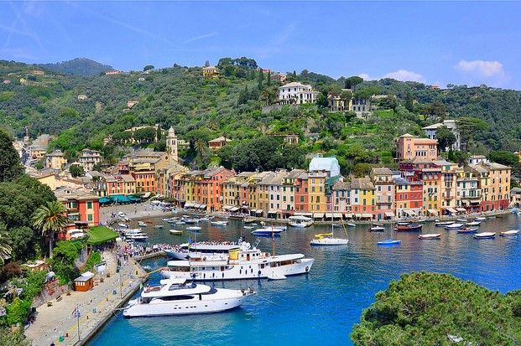
Italy is a mountainous country to a large extent. The climate is mostly subtropical. Mediterranean vegetation, it's evergreen forests, , a large number of shrubs and low stands. Summer in Italy is dry and hot, in winter, moderate temperatures prevail, with lots of rain.

Slide 4
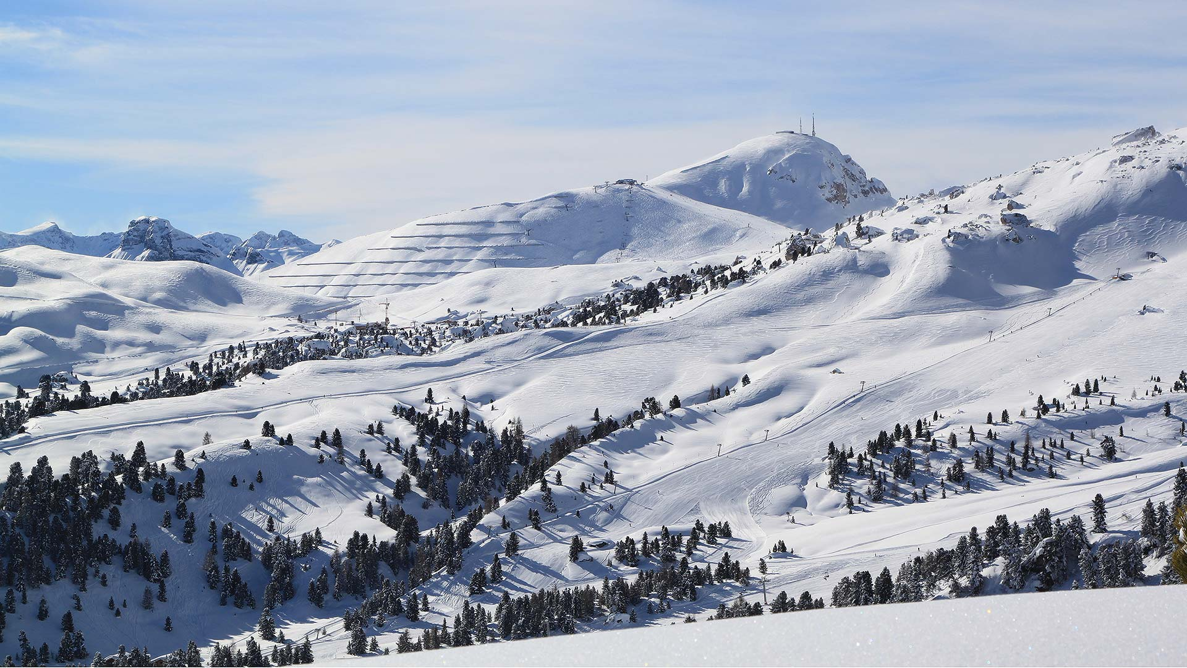
Snow in Italy appears very rarely. In Rome, snow falls on average once every 20 years. the peninsula where Italy is located it reminds a woman's shoe. islands, of which there are over 70, many of them have volcanic origin, and some still have active volcanoes.

Slide 5
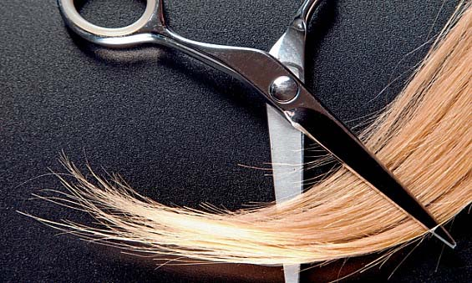
Hair salon :parrucchiere Barber : il parrucchiere Hairdresser: la parrucchiera Hair: capelli Comb: pettine Scissors: forbici Hair dryers: asciugatrice Dry hair: asciugati i capelli To brush hair: pettina i tuoi capelli Shorten hair: accorcia i capelli
Useful phrases that we will use

Slide 6
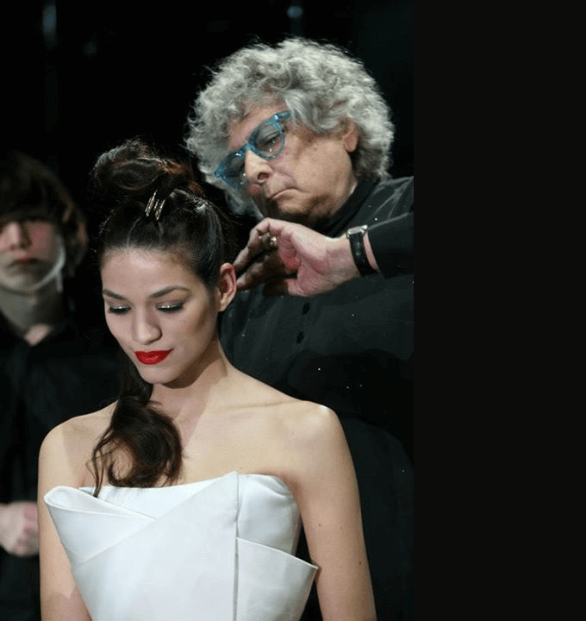
Famous Italian hairdressers
Aldo Coppola is a real innovator in the world of hair, Aldo Coppola has become a reference brand in the world of beauty and fashion, cooperation with the best fashion brands, with the most important photographers and magazines in the world.

Slide 7
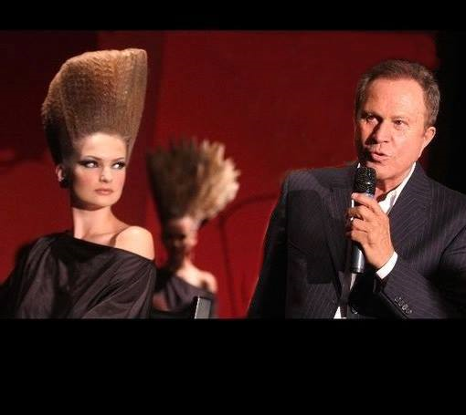
Famous Italian hairdressers
Sergio Valente has become synonymous with the Italian taste of elegance, sophistication and fashion around the world. Sergio Valente has become an Italian hairdresser of models and celebrities. His scissors touch the excluded heads of the world such as: Hillary Clinton or Queen Elizabeth. He definitely set the real trends of the nineties.

Slide 8
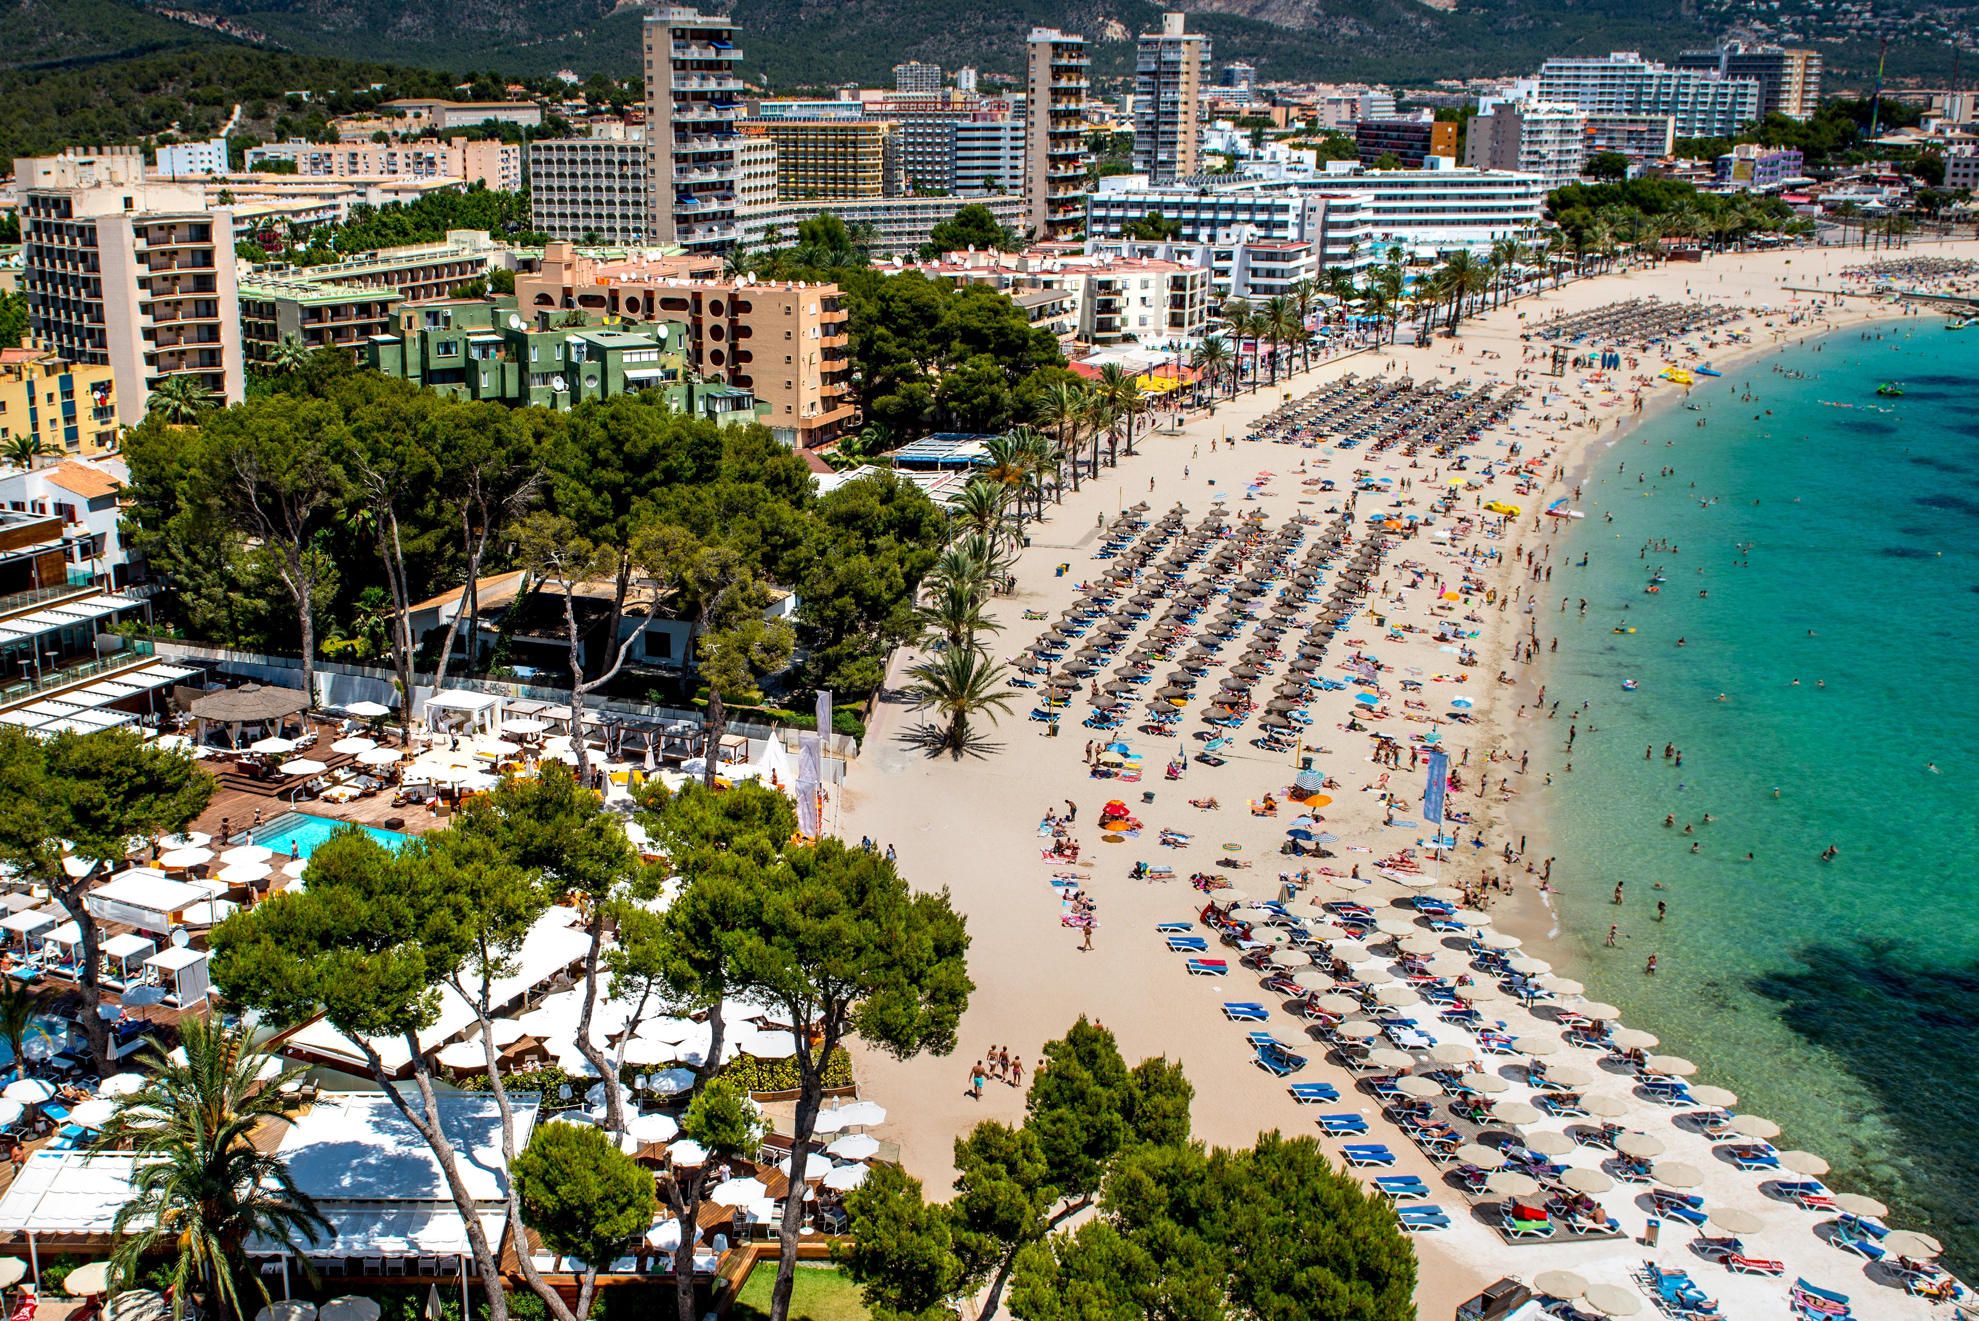
The city we are going to
Rimini is a town and comune in Italy, located on the Adriatic Sea. It is one of the most popular tourist and leisure cities. It is one of the most beautiful and picturesque cities most attracted by the beautiful beach.

Slide 9
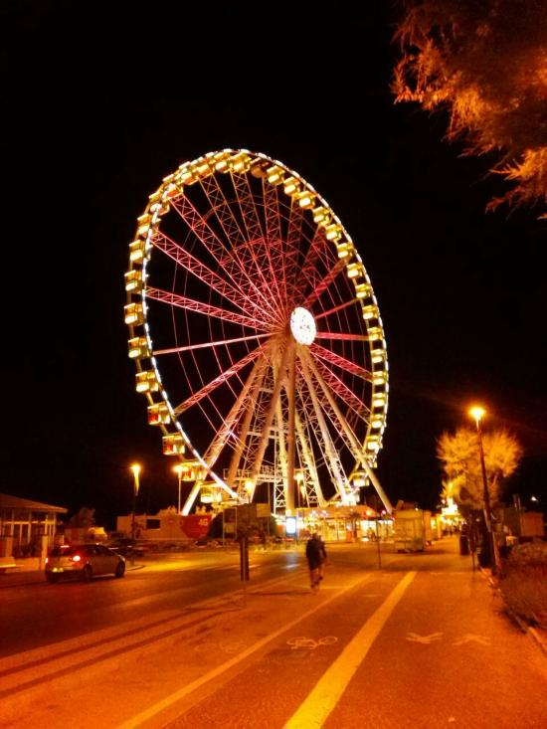
What would I like to see while I'm on the internship?
Being on the internship I would like to see the Rimini Circle, from which you can see the panorama of the entire city, a huge impression in the evenings will leave unforgettable memories. I would like to experience these impressions and unforgettable memories. Not to avoid the beautiful sandy beach and the wonderful sunset of the city of Rimini.

Slide 10
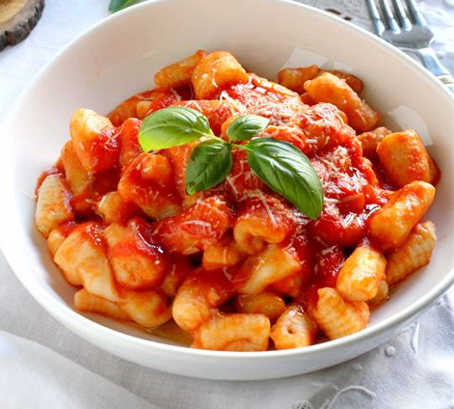
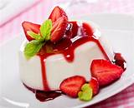
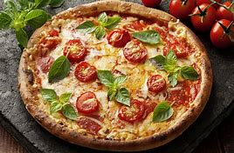
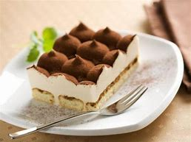
What would I like to eat while in Italy?
The dishes that I would like to eat is primarily Italian pizza which is the most famous there. Other dishes that I want to eat are, for example, Gnocchi that resemble Polish potato dumplings. They differ only in shape. I would also eat Tiramisu Panna Cotta both desserts are known throughout Europe.

Slide 11
Thank you for your attention!

