Slide 1
MY INTERSHIP ABOARD~ ITALY

Slide 2
Italy
LOCATION : Southern Europe
FOREIGN EXCHANGE : Euro
CAPITAL : Roma
OFFICIAL LANGUAGE : Italian
DOMINANT RELIGION : Catholicism
ITALY UNION : 17 march 1861

Slide 3
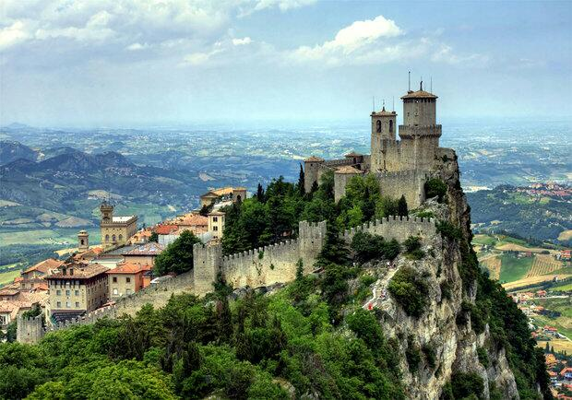
The most popular places
Costa Smeralda
Palermo
Werona
Lake Garda
San Gimignano
Capri
Positano
Taormina

Slide 4
Italy cuisine
One of two most popular european cuisine. Italy cousine are known from flour and fish dishes. Characterize by:
A lot of vegetables,
Spices e.g. : oregano, basil, thyme, rosemary,
Cheese e.g.: parmesan
Olive oil

Slide 5
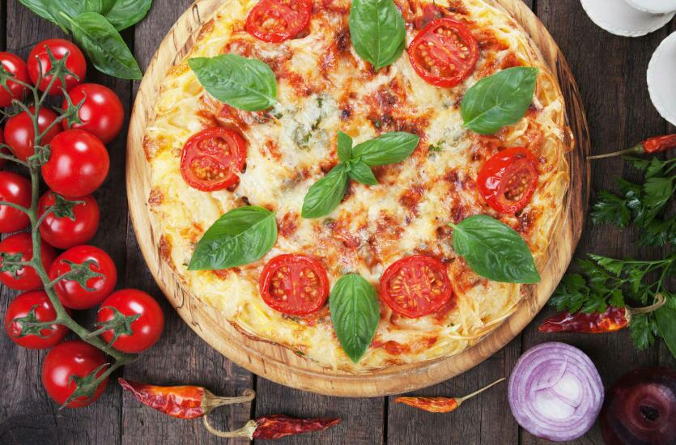
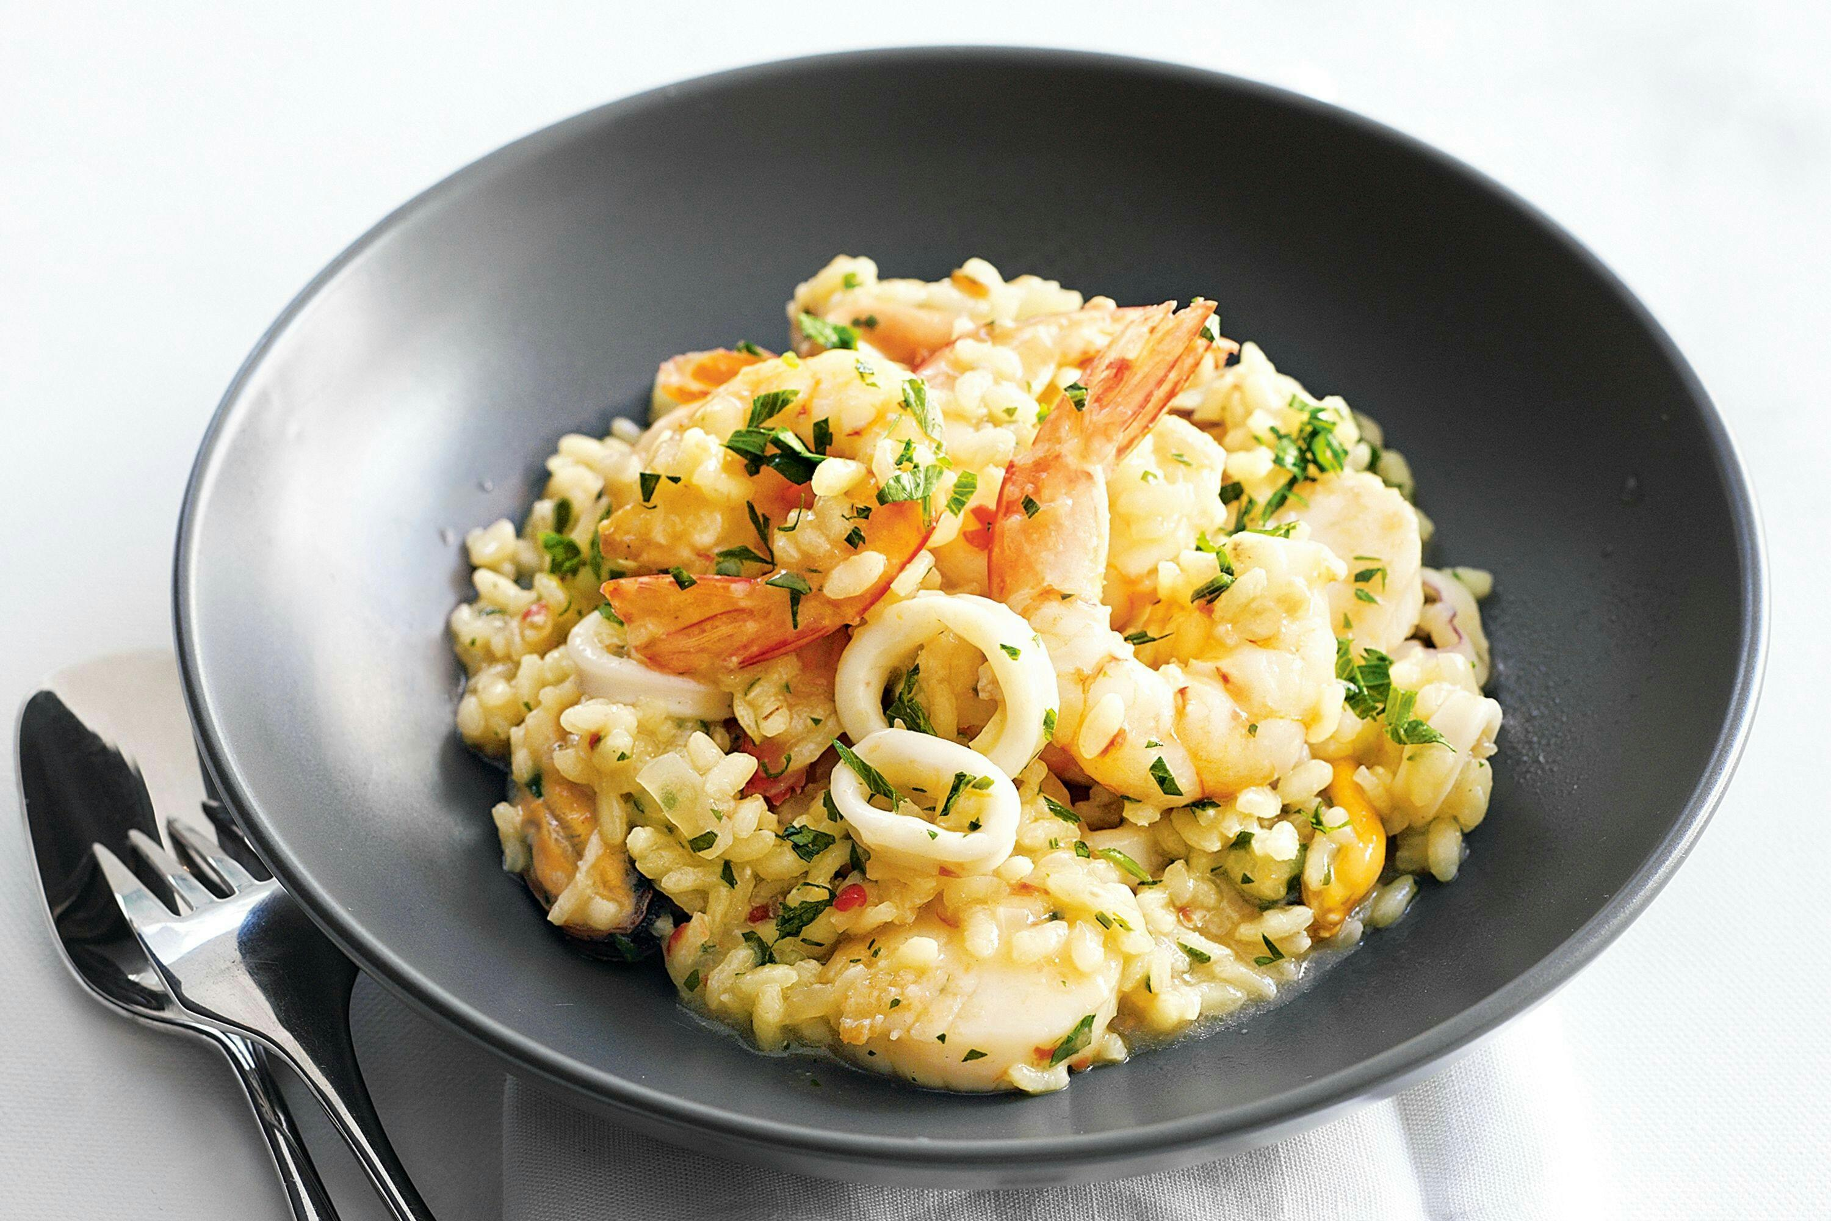
Popular dishes
Lasagne
Ravioli
Risotto
Tiramisu
Pizza
Pasta

Slide 6
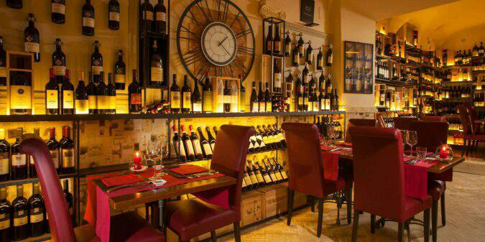
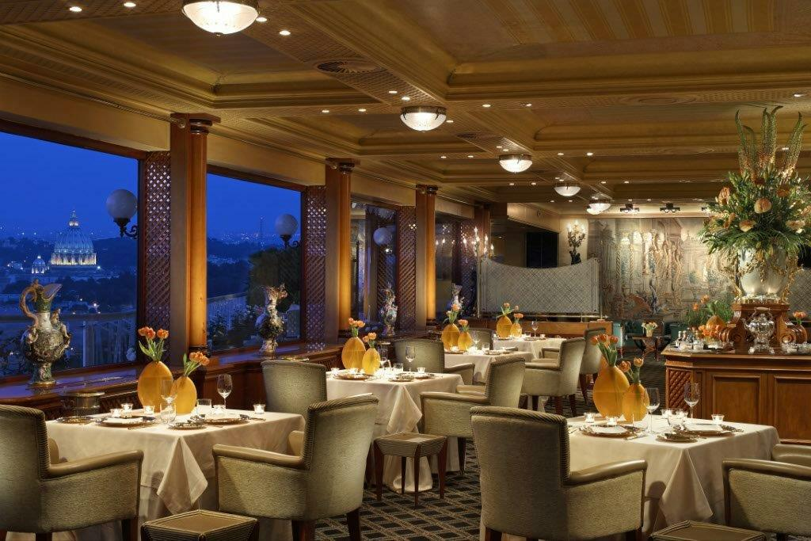
Popular Italian restaurant
Ambrosia Restaurant
MiVà
Tonnarello
Cantina e Cucina
Taverna Lucifero
La Porta Del Principe
La Pergola
Ad Hoc

Slide 7
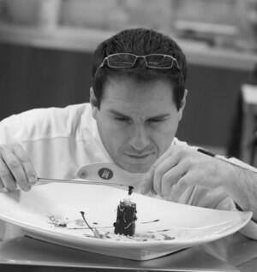
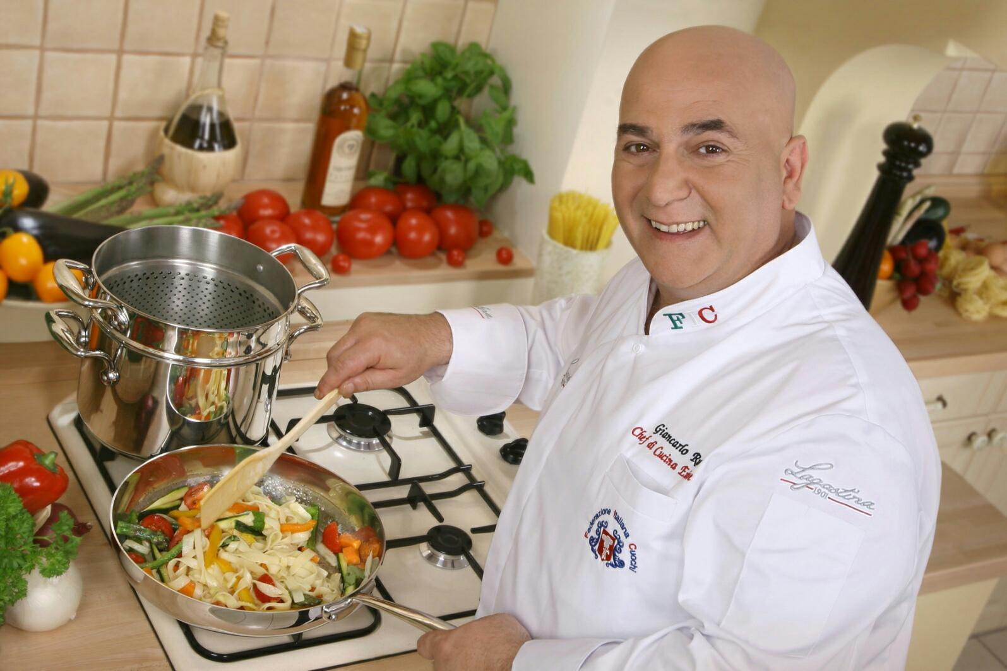
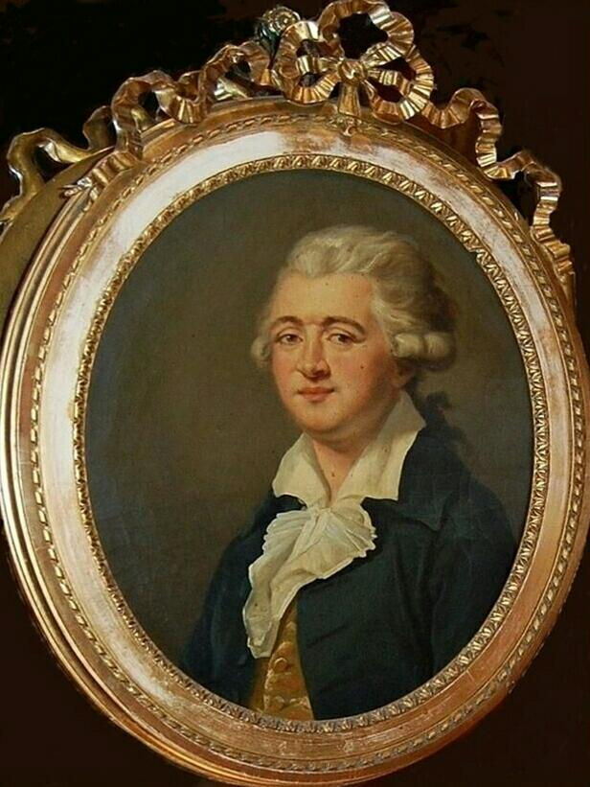
Italian chef’s
Gianfranco Chiarini
Giancarlo Russo
Francesco Procopio Cutò

Slide 8
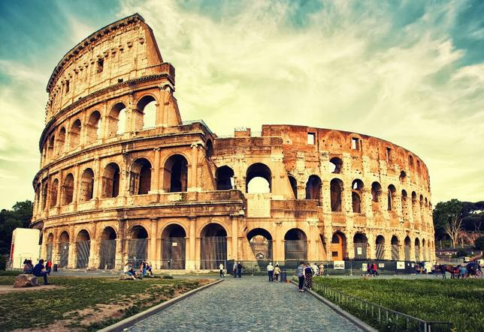
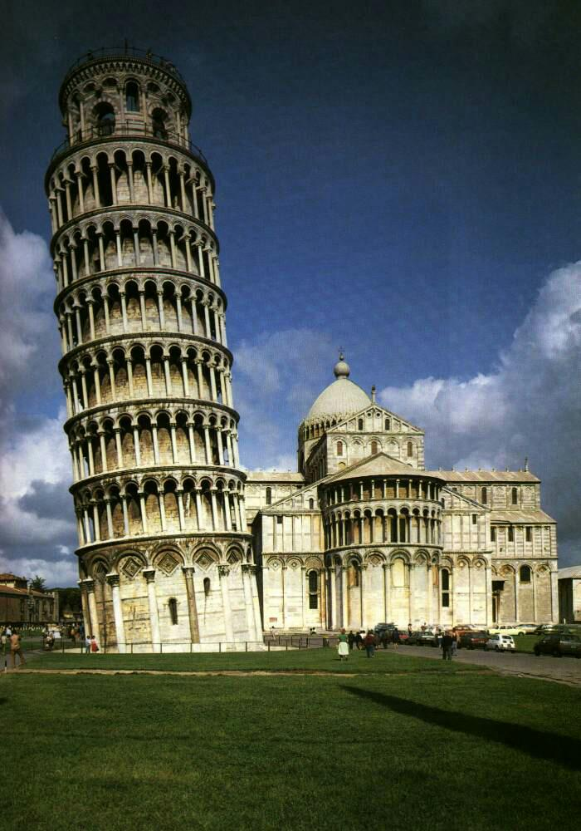
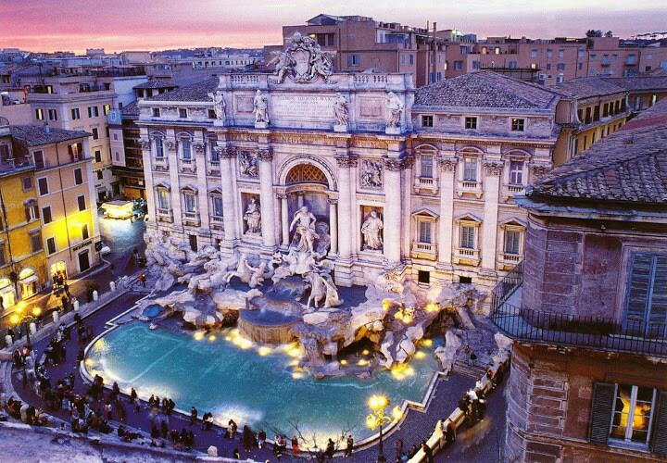
What I like to see in Italy
Trevi Fountain
Colosseum
Leaning Tower in Pisa

Slide 9
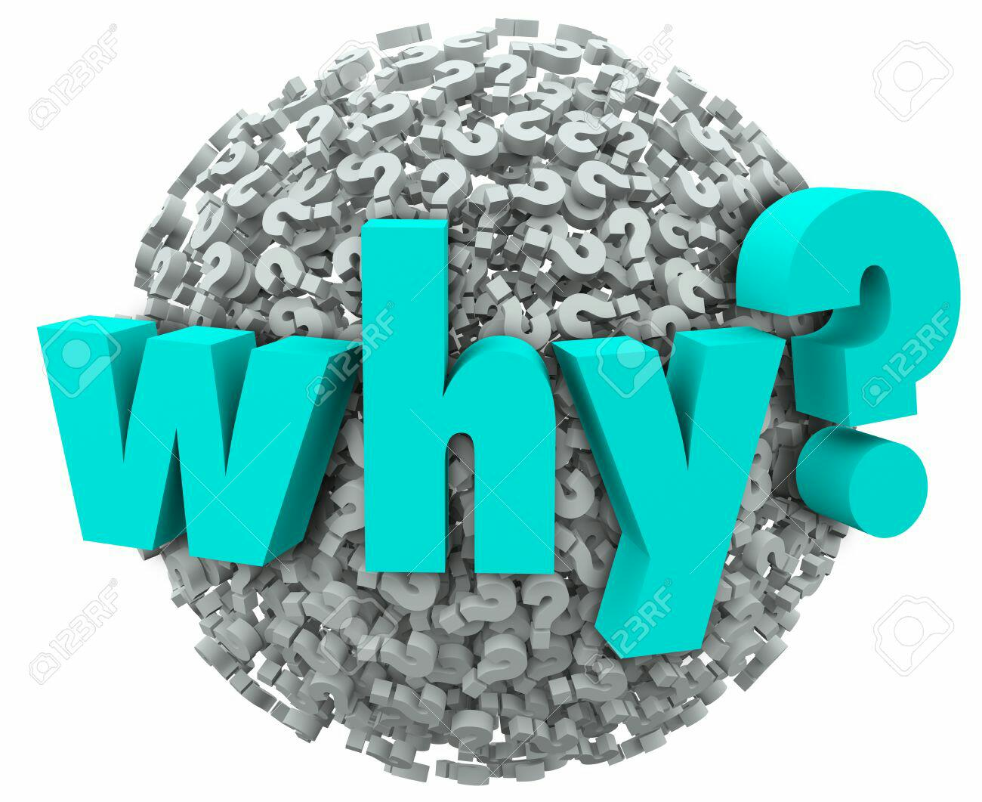
Why Italy ?
During my intership in Italy I could:
Know Italian culture
Learn traditional Italian dishes
Learn some Italian words
Practice my English language

Slide 10
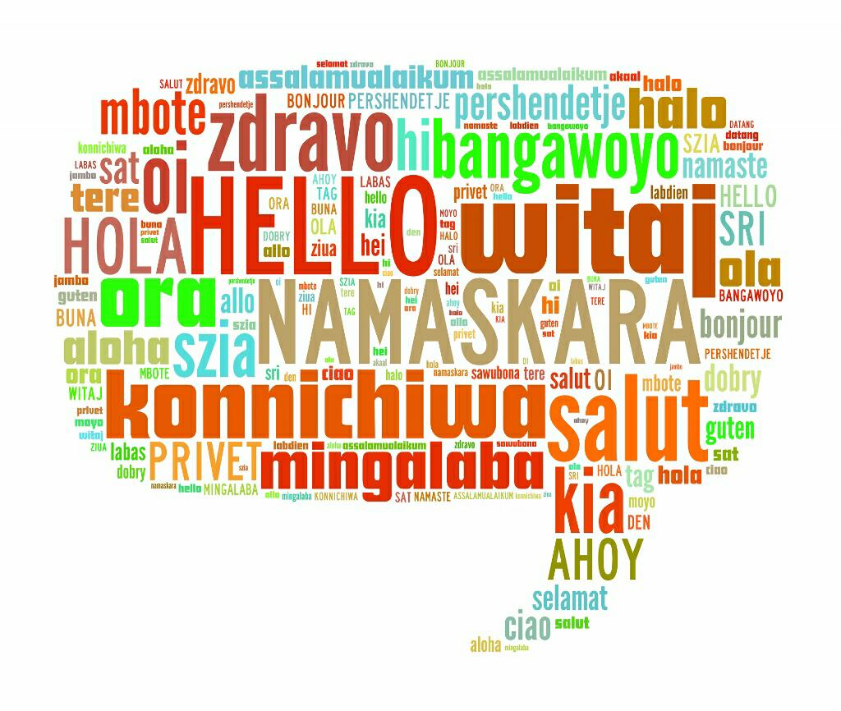
Italian vocabulary
Hello Ciao
Goodbye addio
Yes Si
No No
Please per favore
Thank You Grazie
Excuse me mi scusi
Sorry scusa

Slide 11
PREPARED : Anna Rak kl 2TŻ

