Slide 1
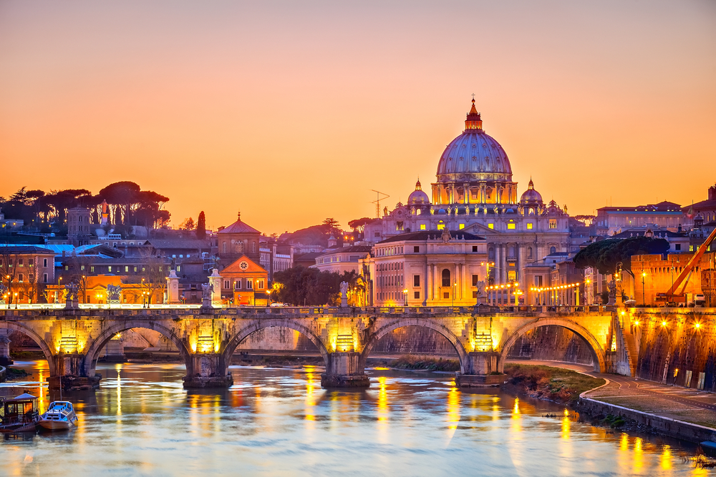
My professional internship in Italy

Slide 2
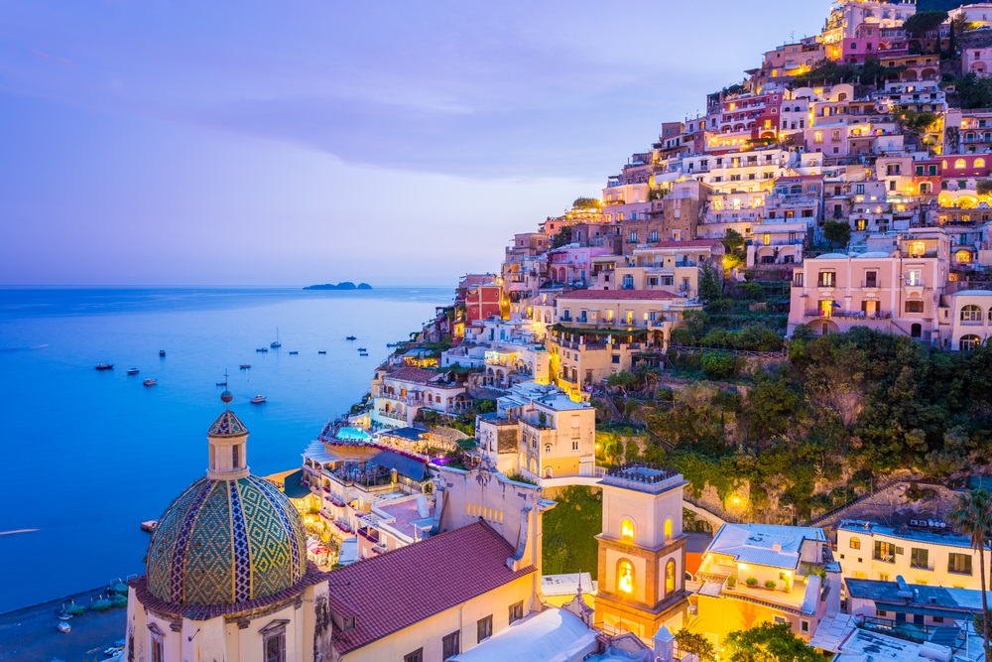
Italy
It is a country located in Southern Europe, on the Apennine Peninsula. The capital of Italy is Rome. The population is 60.6 million. The currency is Italian Lira and Euro. Italy is one of the seven most industrialized and rich countries in the world.

Slide 3
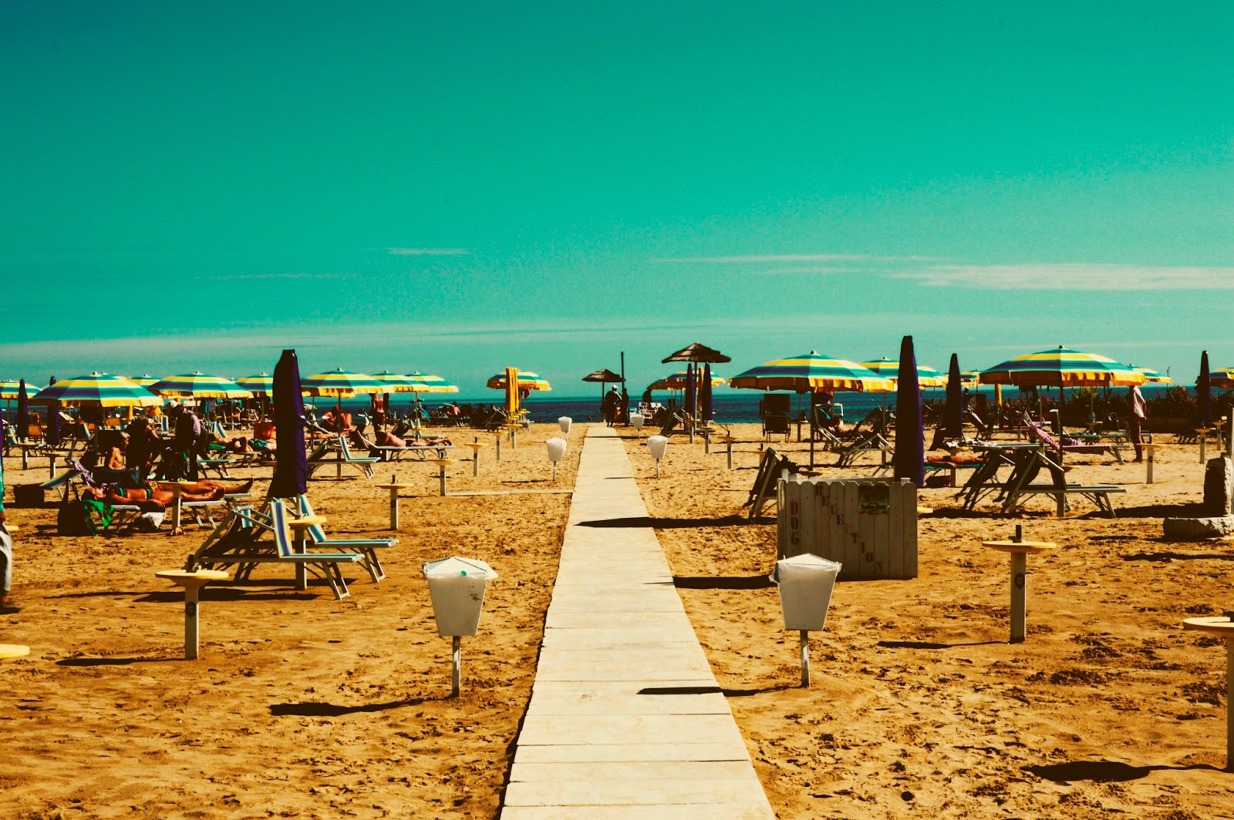
Rimini
It is one of the most popular tourist and holiday cities on the northern Adriatic. Rimini is a town and commune in Italy, in the Emilia-Romagna region. San Marino is not far from Rimini.

Slide 4
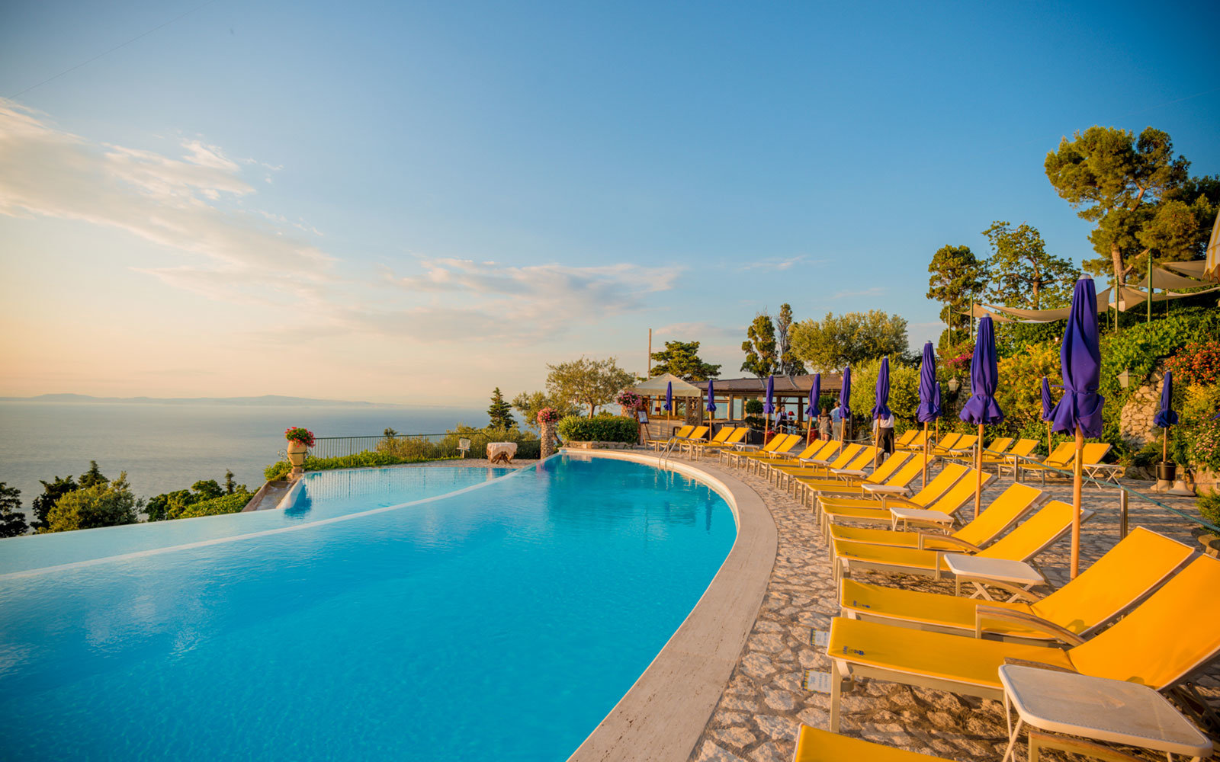
Why I want to fly to Italy for an internship?
I would like to gain knowledge and experience in order to better perform the profession of a hairdressing service technician in the future.
I would like to learn about the culture of this country and the people living there.
I would like to try real Italian cuisine.
I want to see wonderful monuments such as the Forum Romanum, the Colosseum and the Basilica of St. Jana

Slide 5
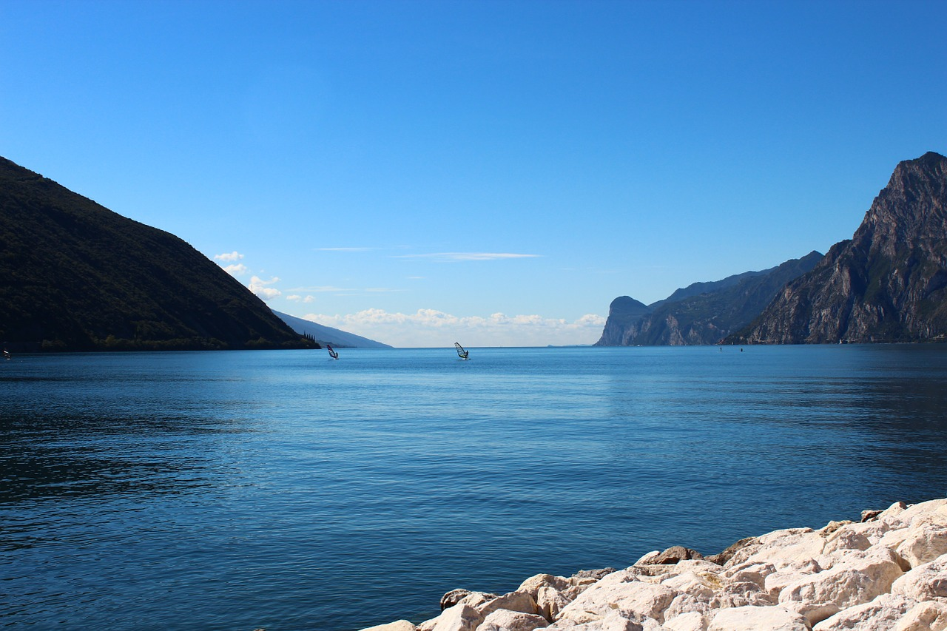
At the hairdresser's in Italian
Hairdresser (fryzjer) is in Italian il parrucchiere,
Hairdresser (fryzjerka) : la parrucchiera.
There is also il barbiere, we use this word mainly for men, because it is a hairdresser who also cuts beard (la barba).
While cutting (cięcie) it il taglio (di capelli)
Hairstyle (fryzura,upięcie) it l’acconciatura
The ends of hair (końcówki włosów) it le punte, or split ends (rozdwojone końcówki) it le doppie punte.
Bangs (grzywka) it : la frangia,
When we talk about shaving a beard (broda), we rather use the term fare la barba. Mustache (wąsy) it i baffi, sideburns (bokobrody): le basette

Slide 6
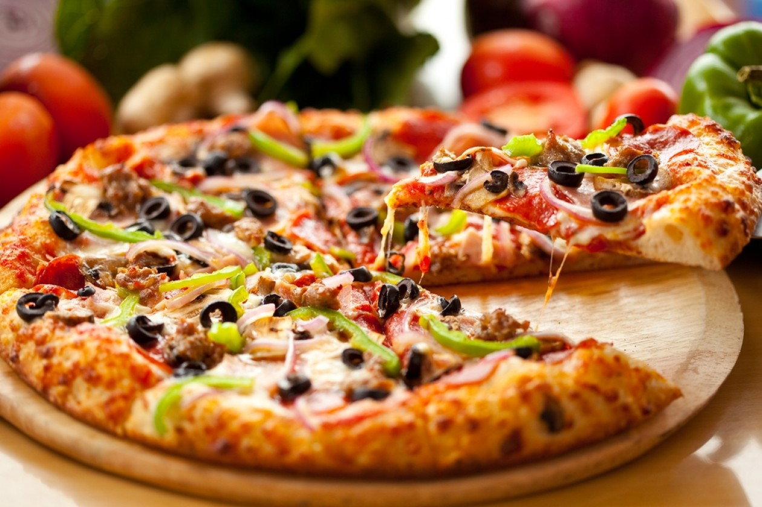
The most popular Italian dishes

Slide 7
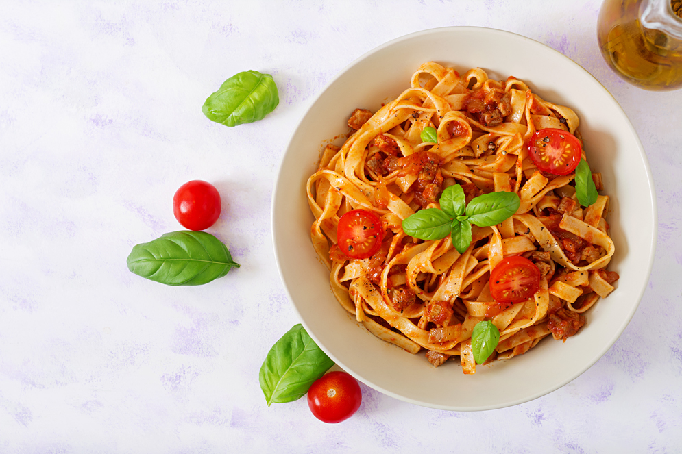
Pomodoro
Pomodoro is a "tomato" in Italian. In restaurants, we often meet as "Pasta Pomodoro" dish. It is a simple dish of pasta with tomato sauce, which consists of olive oil, fresh tomatoes and basil.

Slide 8
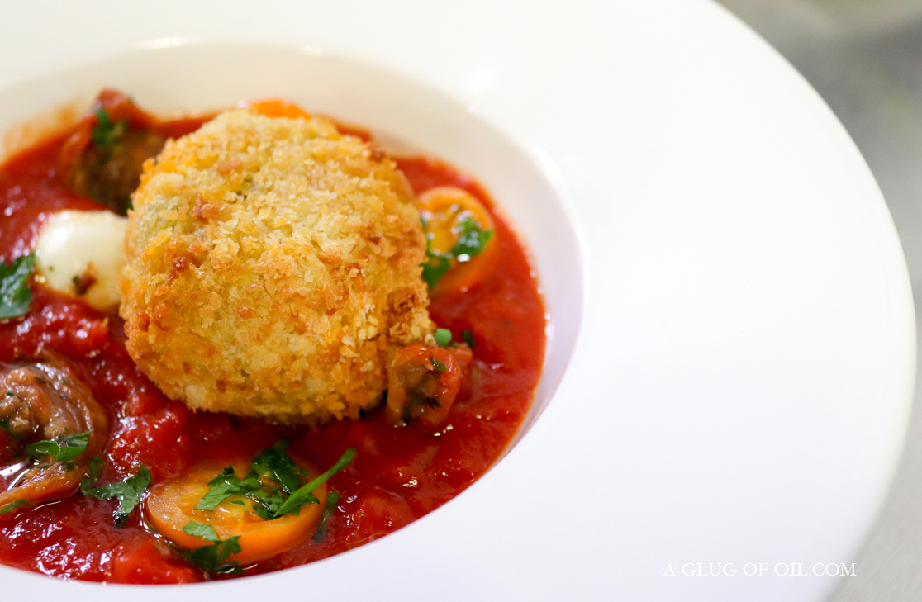
Arancini
Arancini is stuffed and fried rice balls in breadcrumbs. They take their name from the word "arancia", which means "orange" in Italian. The name comes from shape and color. Depending on the region, arancini may be served with meat, tomato sauce, mozzarella, peas and mushrooms. The dish is often served as a snack. It is a typical dish of Sicilian cuisine.

Slide 9
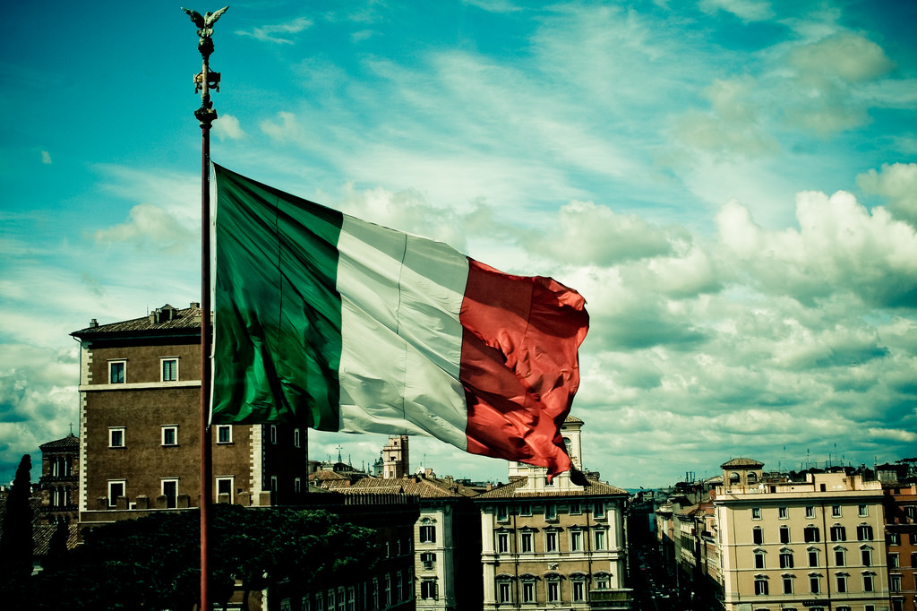
What to see in Italy?

Slide 10
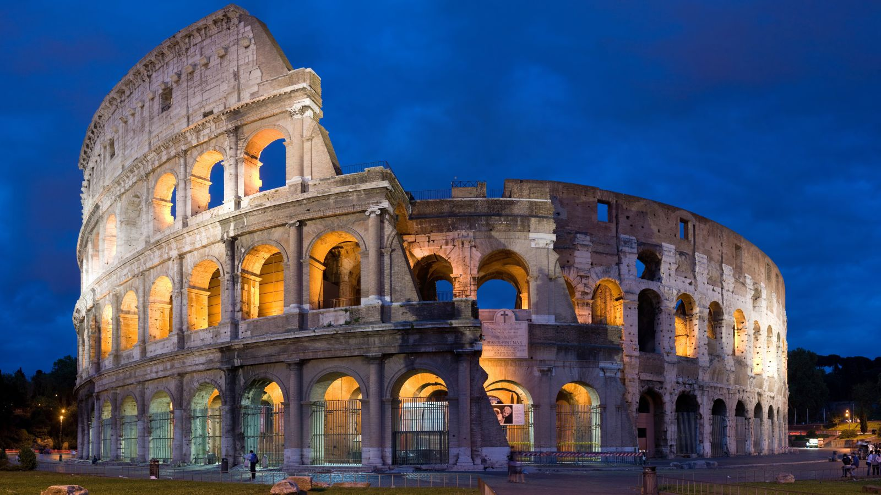
The Colosseum
The Colosseum, officially erected in antiquity– amphitheater in Rome, erected in 70-72 to 80 e.e. by the emperors from the Flavian dynasty.

Slide 11
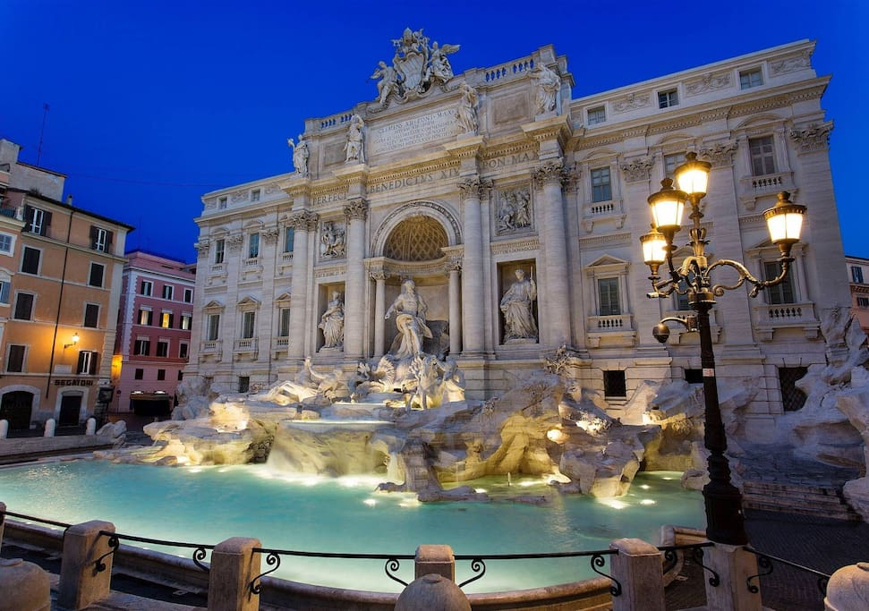
Trevi Fountain
The most famous baroque fountain in Rome, in Rione Trevi. It was built on the initiative of Clement XII in the place of an existing fountain designed by Leon Battiste Alberti from 1435.

Slide 12
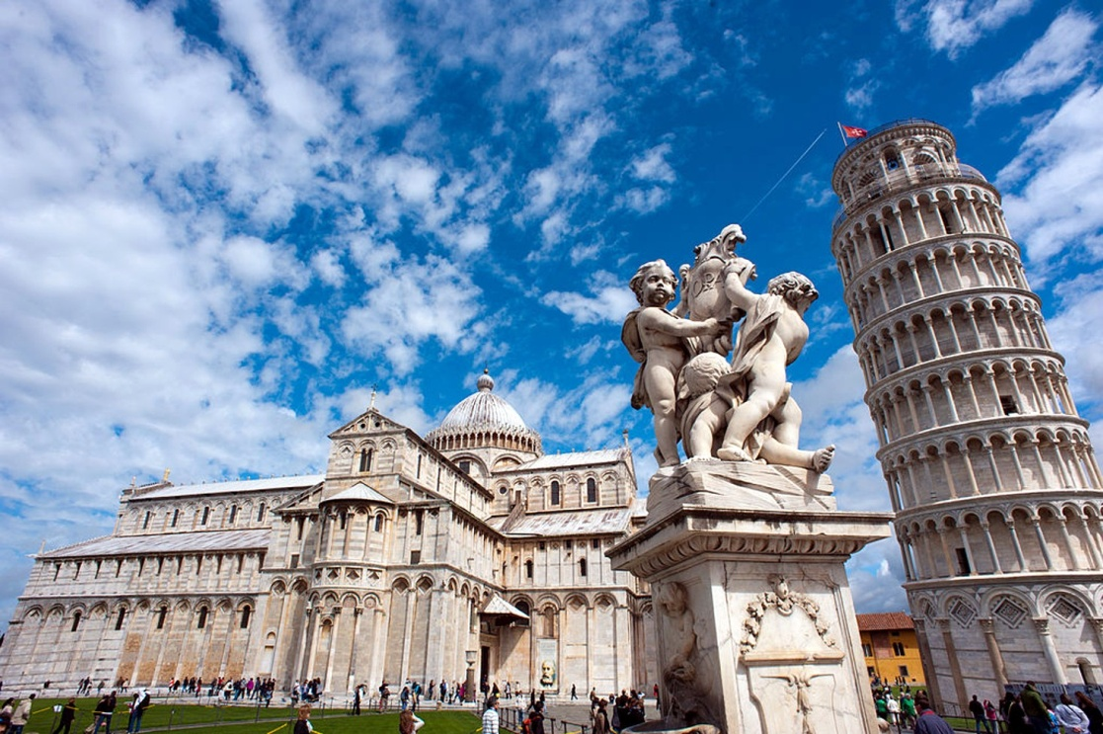
The Leaning Tower of Pisa
The Leaning Tower of Pisa - one of the most famous buildings in the world, visited by about 10 million tourists annually; symbol of the city of Pisa.

Slide 13
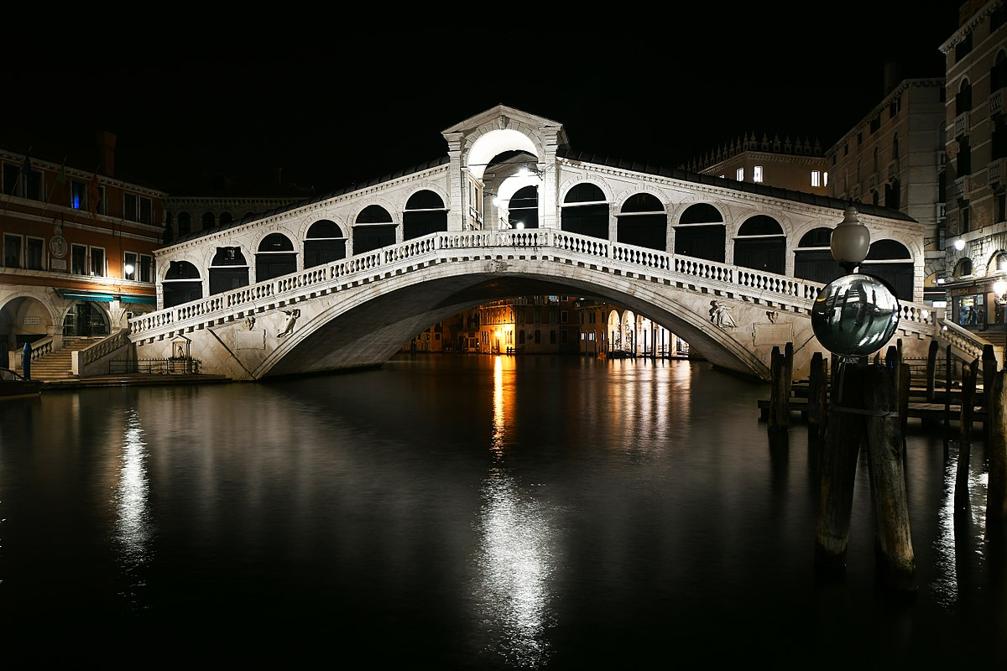
Rialto Bridge
The oldest and only one until the Ponte dell'Accademia was built in 1854, the Venetian bridge over the Grand Canal in Italy. It connects the shores of Riva del Vin and Riva del Ferro.

Slide 14
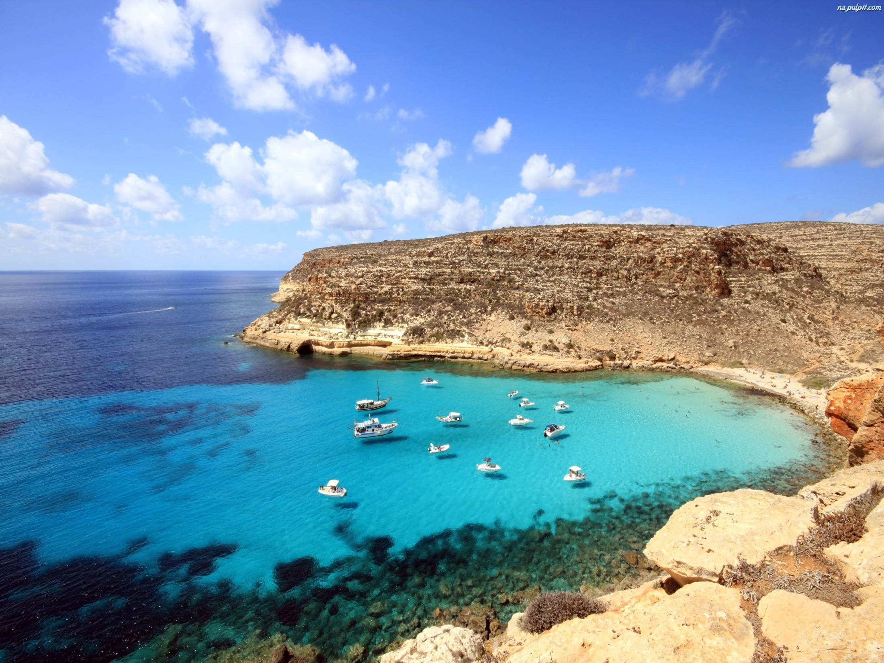
Thank you for your attention! Author: Klaudia Przednowek

