Slide 1
My internship in Portugal
Michał Daszykowski kl. 2 TWA

Slide 2
Portugal – the country of balance
For a long time I have been wondering what an internship in Portugal means to me…
After having many conversations, conducting interviews, reading articles and thinking about it… I am getting to a conclusion that I would like to undergo
the internship in Portugal as the country of balance.
I mean the balance on three levels that overlap and influence each other…

Slide 3
Portugal – the country of balance
Balance of body and soul
Balance of fauna and flora
Balance of
land and water

Slide 4
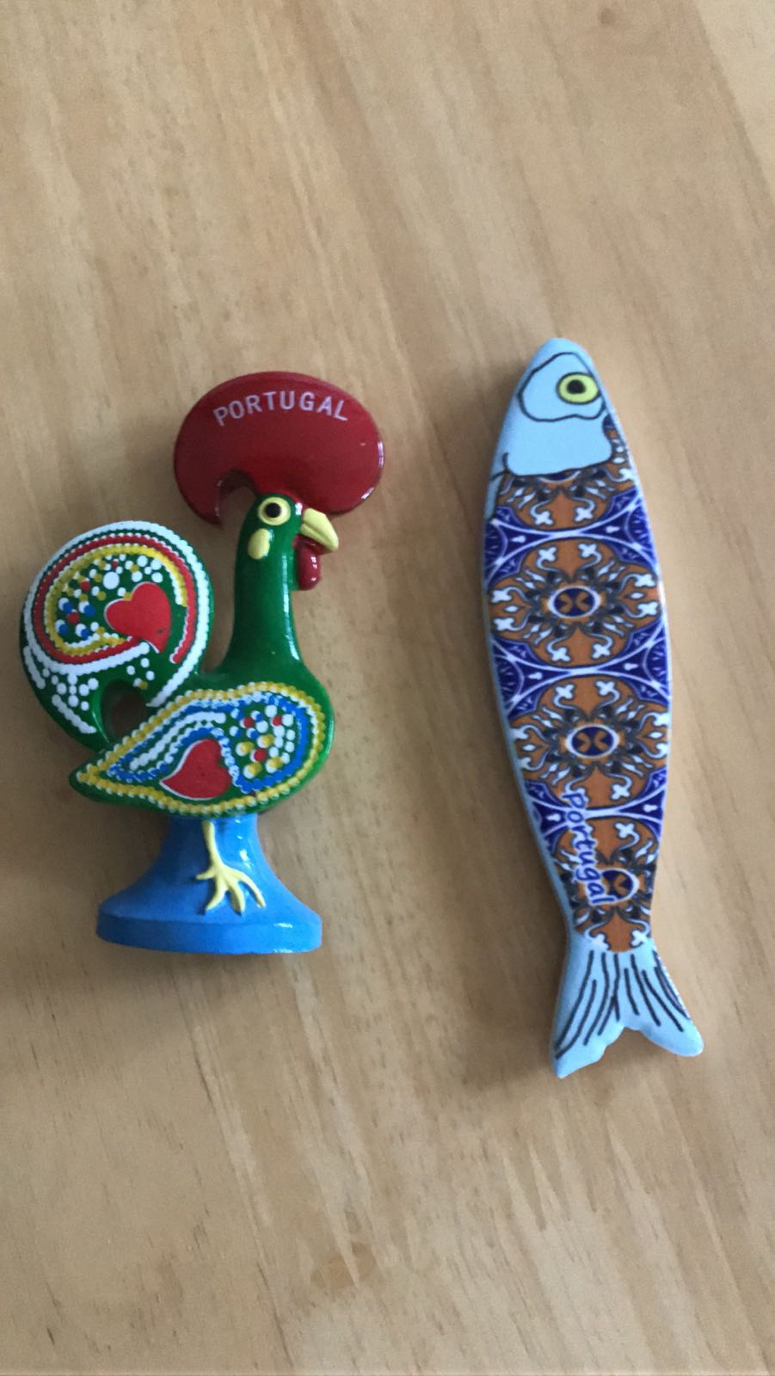
Portugal – balance of land and water
Portugal has got two symbols –
the rooster and the Sardine fish.
The rooster – according to a Portuguese
legend, symbolizes people living on
this land as honest, honourable and
always ready to fight for the truth.
Sardines play an important role in
Portuguese cuisine – Both locals and tourists
enjoy them during popular festivities –
like Saint Anthony’s day, June 13
when grilled sardines are the favourite snack.

Slide 5
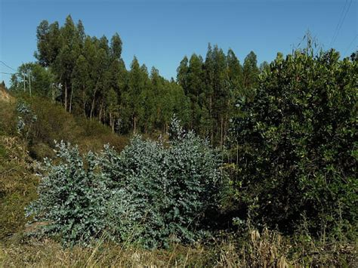
Portugal – balance of land and water
Portugal is an incredibly picturesque country.
The subtropical climate, additionally influenced by the ocean, and closeness to Africa and Europe make plants green.
Forests constitute 41% of the land. The climate also fosters the development of vineyards and eucalyptus plantations.
The precipitation is only in the form of rain.
The average temperature in winter
is 8-10℃, in summer is 22℃.

Slide 6
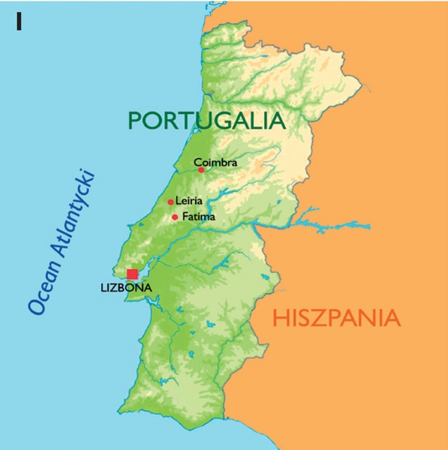
Portugal – balance of land and water
The fish – symbolizes the closeness of this country
to the ocean and the diversity of water fauna and
flora. It represents the beauty of the coastlines that
is appreciated and used not only by Portuguese
people.
The influence of the ocean on the land is visible in:
The development of fishing (there are 200
species of fish and seafood near the coast)
The catching of seaweed - used to fertilize
the land
The positive impact it has on a body and soul
(relaxation and beauty of the landscape)

Slide 7
Portugal – balance of body and soul
The balance of land and water has its impact on the physical and psychological balance of the people living in Portugal.
Portuguese:
Are the nation of brandos costumes which means nation of mild manners & customs
Are hospitable, helpful and sociable – similar to Polish
They gained the skill to find and use pleasures of life
Religion plays an important part in their spiritual development
Love to play during festivals and celebrations of patrons of particular cities and villages

Slide 8
Portugal – balance of body and soul
Portuguese work on their balance of body by:
Food culture
The times of meals are treated as sacred
Meals set the day rhythm, they are eaten slowly, after finishing nobody rises too quickly from the table
Portuguese cuisine is rich in fish, seafood (very healthy to the body), but also in different kinds of meat, vegetables and fruit
Codfish, sardines, shellfish – the gifts of the ocean
Not only the quality of ingredients is important but also their originality and freshness

Slide 9
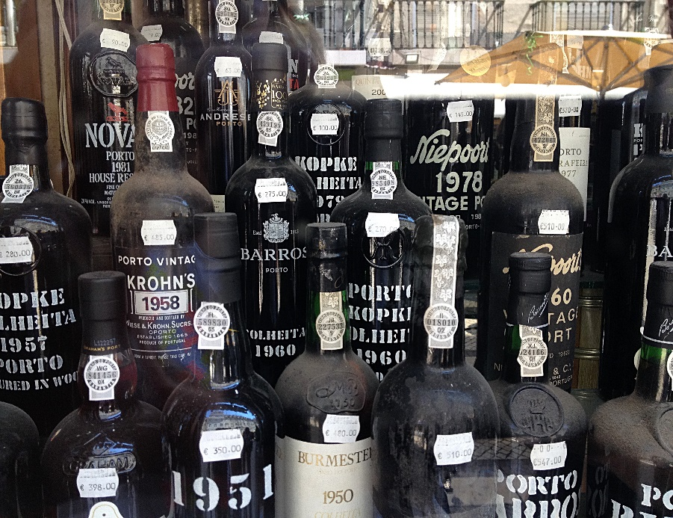
Portugal – balance of body and soul
Wine production and the culture of drinking
Portuguese are experts in cultivating grapes and in production of a very good quality wine
this specialization is the result of the tradition of producing this drink for centuries
wine is not treated as just alcohol
but as a regular drink served with a meal
pouring wine to oneself is not
a rare situation
against the etiquette,
Portuguese women often pour wine
to themselves and others

Slide 10
Portugal – balance of body and soul
Ritual de digestao means… the ritual of digesting
After every meal Portuguese have their own digestao… time to digest.
Some have two, others have three hours of it…
During digestao they don’t drink water, eat, have a bath, get into the sea, they don’t workout in order to not cause any shock which may stop the digestion process and lead to poisoning.

Slide 11
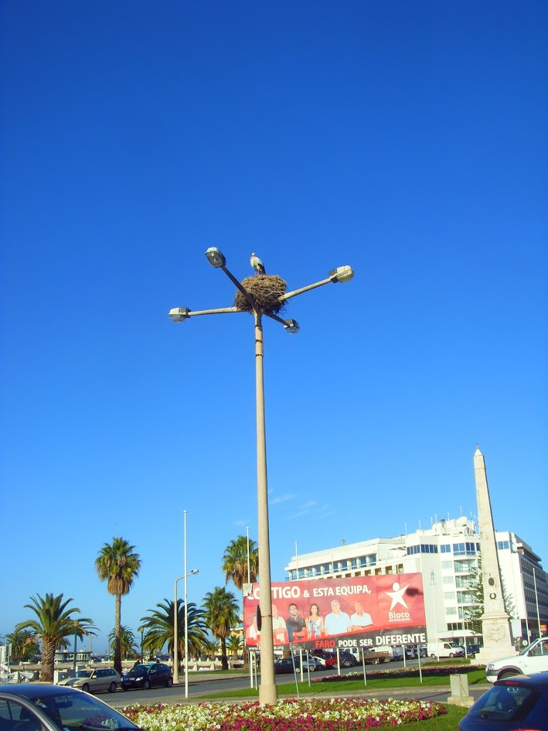
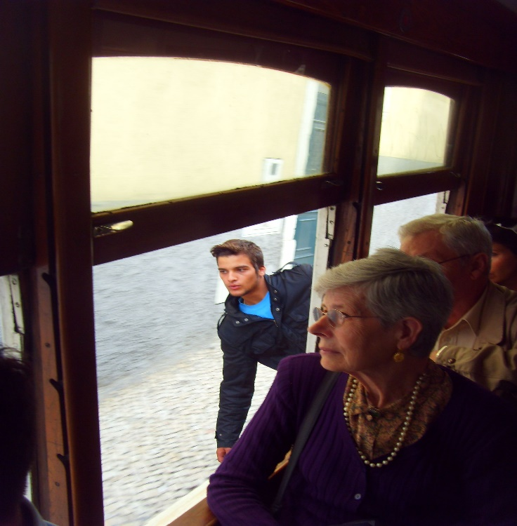
Portugal – balance of body and soul
Soul balance is the culture of living based on no stress philosophy
living in peace without any rush
there is always time for a cup of coffee and a chat with friends
a very important word is respeito which means respect and tolerance towards life, other people, nature, animals and plants

Slide 12
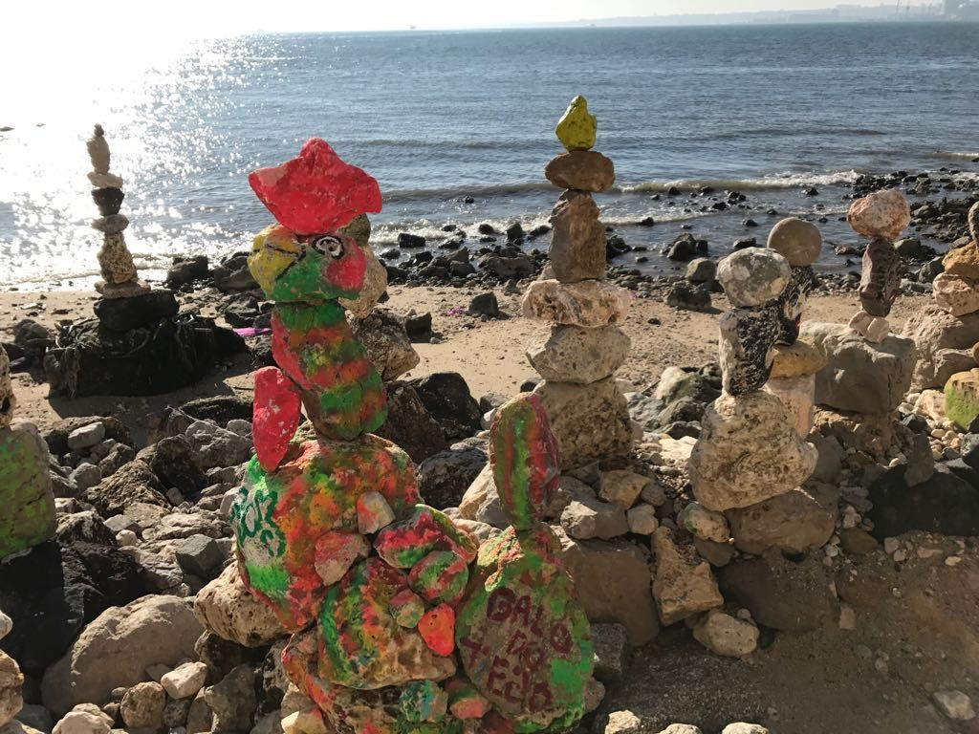
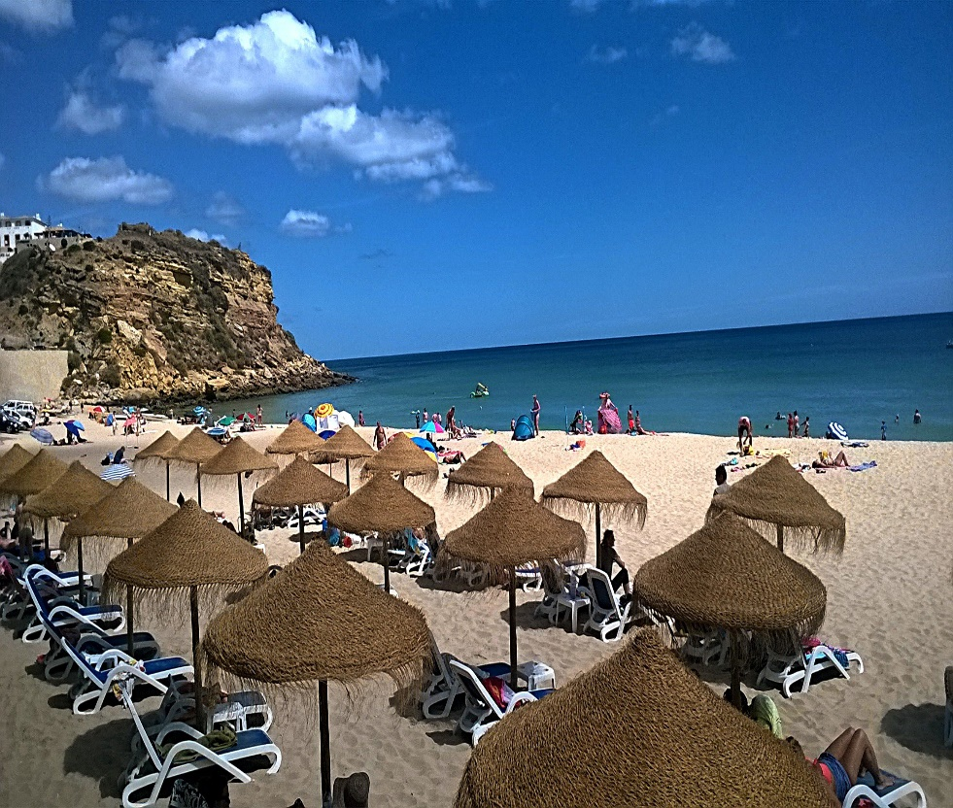
Portugal – balance of body and soul
Richness and serenity of soul are fostered by wonderful coastline landscape.

Slide 13
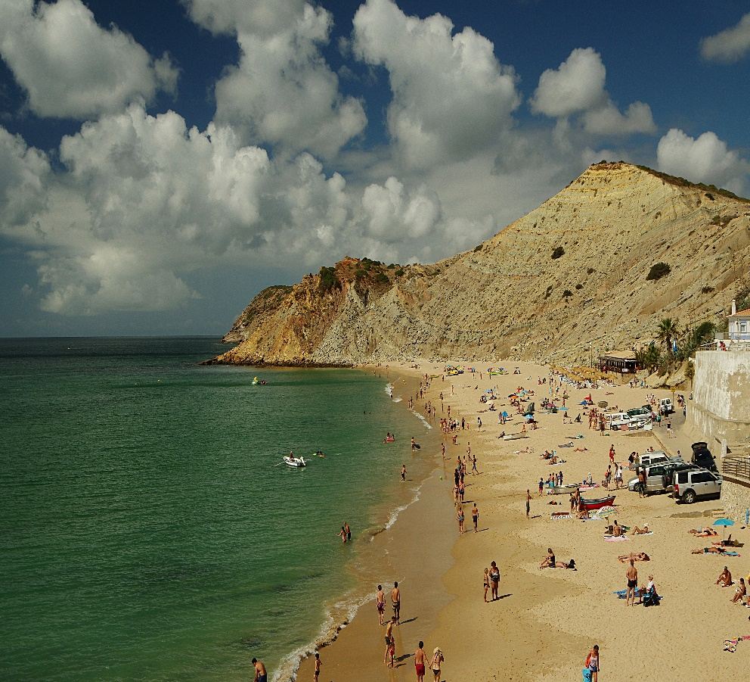
Portugal – balance of body and soul

Slide 14
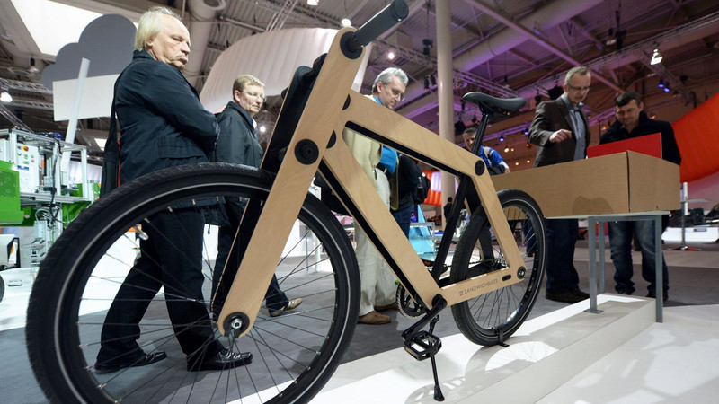
Portugal – ecological balance
Portugal cares for ecological balance.
The best example of that is manufacturing of wooden bikes in the city of Ovar by Mud Wood Company. Wood or cork, from which the constructions of bikes are created, come from wood industry waste.
Wise U is the Portuguese Company that specializes in manufacturing
of bike from ecological waste
(Angel brand).
These bicycles are a perfect means
of transport to promote ecology
and they are produced on
a massive scale.

Slide 15
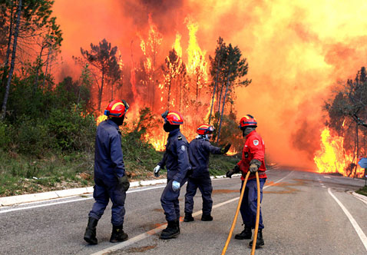
Portugal – ecological balance
In May 2017, a government regulation was introduced to guarantee 10% of country’s income derived from hunting to be spend on protection and development of forests and on research and renewal of the forest fauna population.
In accordance with Portuguese Hunting Federation (Fencaca) 100 000 of people have got a license allowing them to hunt.
This fact is vital when it comes
to rebuilding of the wood supplies
and animals population that suffered
in fires in Portuguese forests.
It is about fast ecosystems rebuilding.

Slide 16
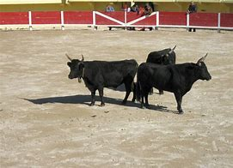
Portugal – ecological balance
Tourada – Portuguese corrida.
The tradition of corrida is getting less and less popular among peaceful Portuguese people. But, so far, it still exists…
However, bulls are not killed during this event (opposite to the bloody Spanish corrida).
Toreadors fight with their bare hands.
The fight has got more of a symbolic
meaning, it is about defeating a negative
beast inside oneself.

Slide 17
Portugal – ecological balance
I have shown three levels of balance which overlap and influence each other.
The general life balance depends on each and particular component.
It seems to me that Portugal is the country where these levels overlap.
I would like to investigate that during my internship.

Slide 18
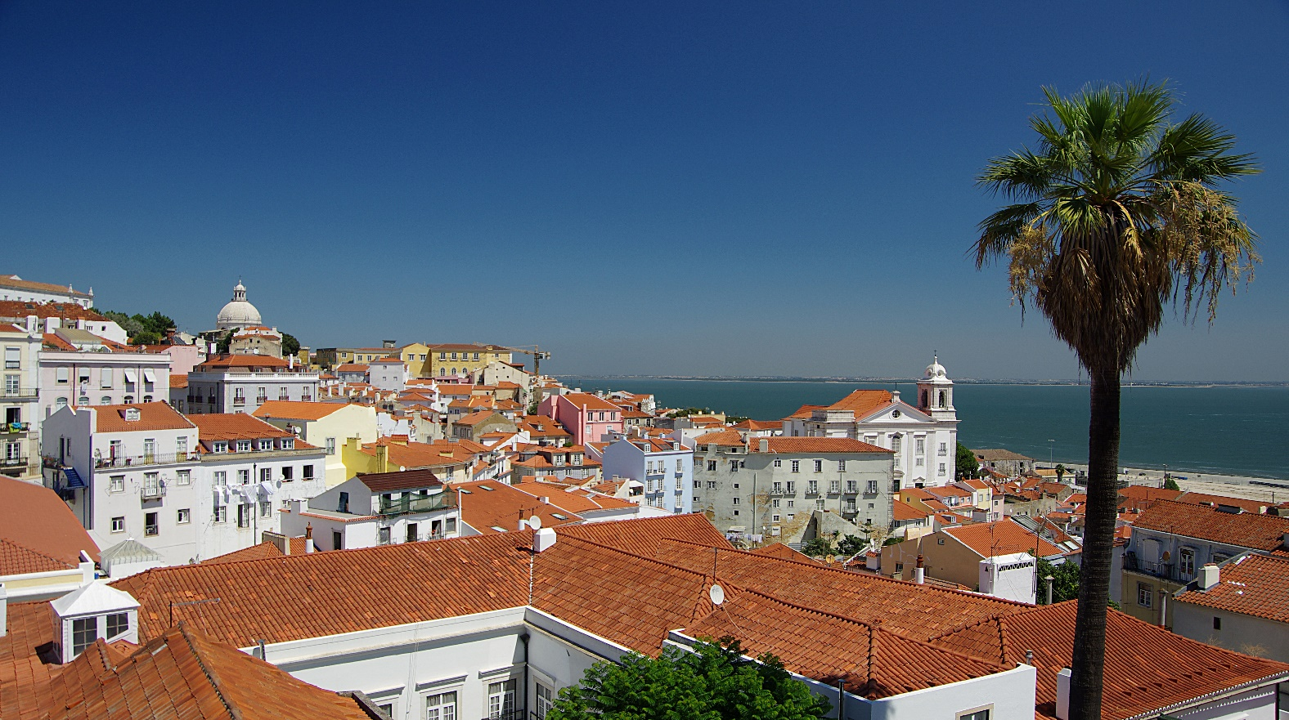
Portugal – the country of balance
Thank you for your attention.

Slide 19
Portugal – the country of balance
Special thanks to:
My Uncle Marcin Koniuszy and Elder Trindade for photos
Kamila Kulisiewicz for photos too

